Slide 1
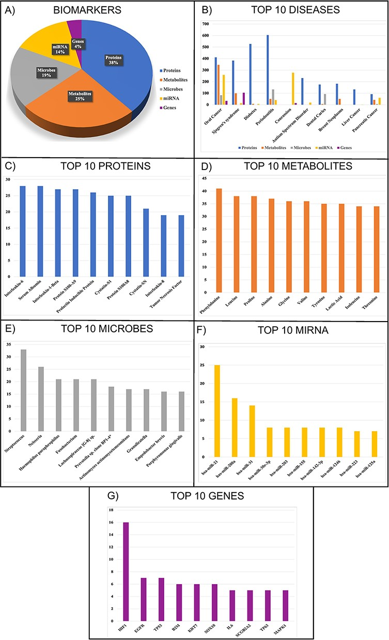
Figure 2. Statistics of (A) biomarkers in SalivaDB, (B) top 10 diseases, (C) top 10 proteins, (D) top 10 metabolites, ...
Notes:
Figure 2. Statistics of (A) biomarkers in SalivaDB, (B) top 10 diseases, (C) top 10 proteins, (D) top 10 metabolites, (E) top 10 microbes, (F) top 10 miRNA and (G) top 10 genes in SalivaDB based on the number of entries.
Unless provided in the caption above, the following copyright applies to the content of this slide: © The Author(s) 2023. Published by Oxford University Press.This is an Open Access article distributed under the terms of the Creative Commons Attribution License (https://creativecommons.org/licenses/by/4.0/), which permits unrestricted reuse, distribution, and reproduction in any medium, provided the original work is properly cited.

