Slide 1
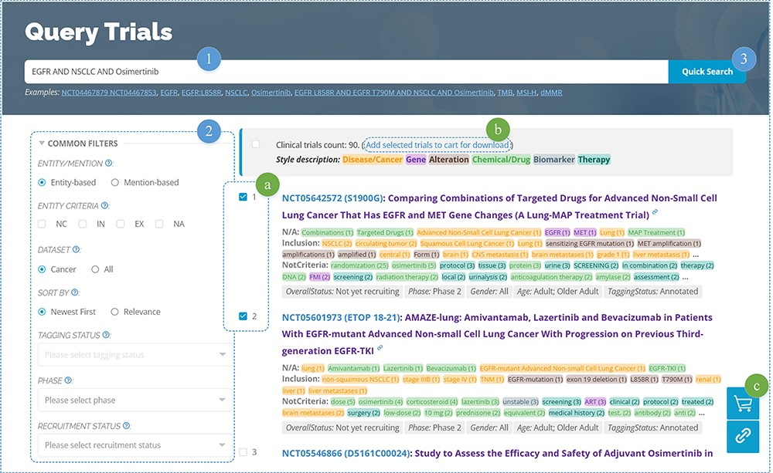
Figure 5. Clinical trials searching.
Notes:
Figure 5. Clinical trials searching. 1) Enter entity-related keyword(s), 2) set filters, and then 3) click the search button to display the search results. Additionally, users can (a) select different trials and (b) add them to their trials cart for subsequent download.
Unless provided in the caption above, the following copyright applies to the content of this slide: © The Author(s) 2023. Published by Oxford University Press.This is an Open Access article distributed under the terms of the Creative Commons Attribution License (https://creativecommons.org/licenses/by/4.0/), which permits unrestricted reuse, distribution, and reproduction in any medium, provided the original work is properly cited.

