Slide 1
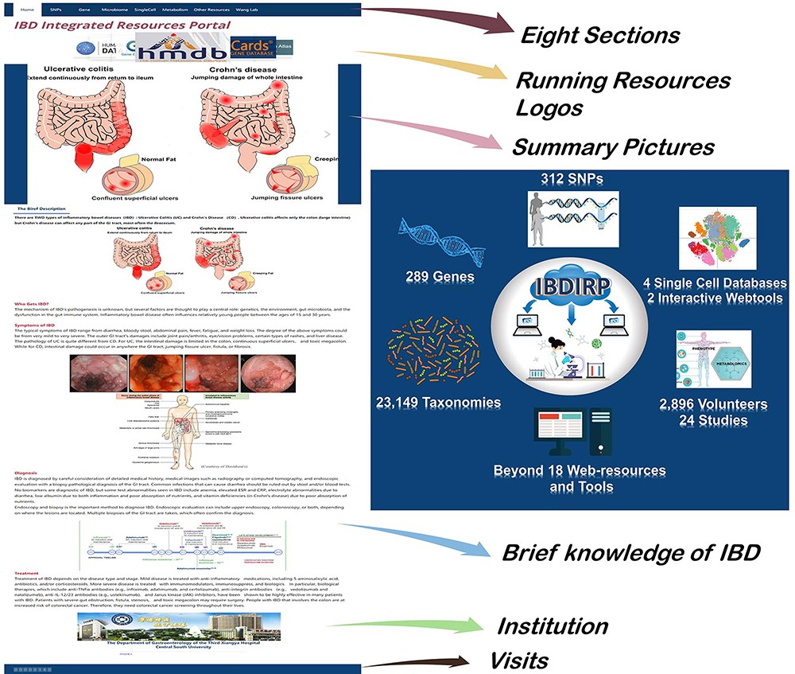
Figure 1. The homepage’s introduction and the overview of IBDIRP website. IBDIRP sorted and cataloged more than 320 ...
Notes:
Figure 1. The homepage’s introduction and the overview of IBDIRP website. IBDIRP sorted and cataloged more than 320 unique risk SNPs associated with IBD, 289 IBD-related genes, 153 IBD transcriptomics data, including 12 388 samples, 23 149 IBD-related taxonomic records, 24 IBD metabolomics studies with 2896 participants, 18 significant IBD web resources and other useful research resources. Alt Text: The homepage’s introduction and the brief overview of IBDIRP website.
Unless provided in the caption above, the following copyright applies to the content of this slide: © The Author(s) 2024. Published by Oxford University Press.This is an Open Access article distributed under the terms of the Creative Commons Attribution License (https://creativecommons.org/licenses/by/4.0/), which permits unrestricted reuse, distribution, and reproduction in any medium, provided the original work is properly cited.

