Slide 1
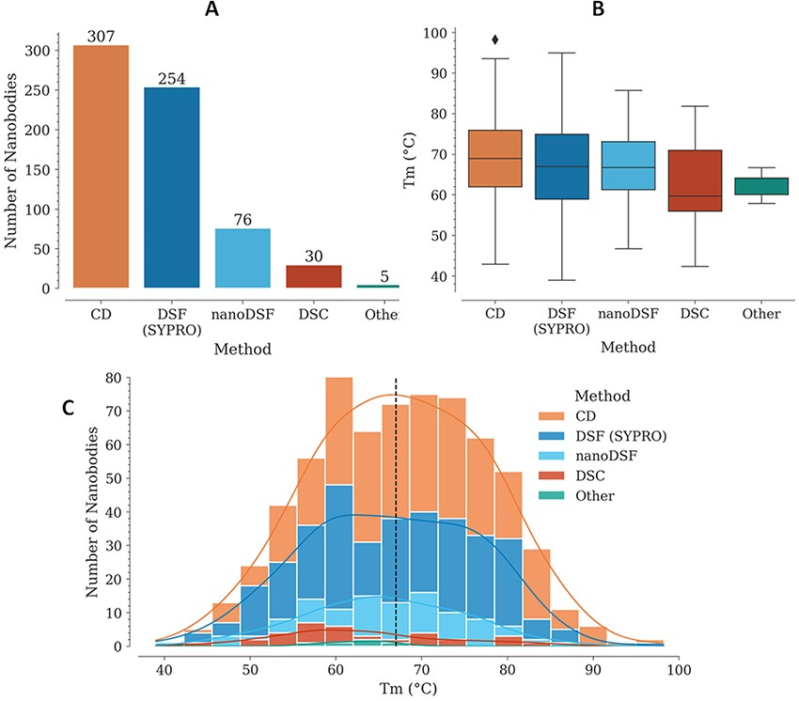
Figure 1. T_{m} data in the NbThermo database. (A) Distribution of T_{m} measurements by experimental ...
Notes:
Figure 1. Tm data in the NbThermo database. (A) Distribution of Tm measurements by experimental methods: CD, DSF with SYPRO Orange, nanoDSF and DSC. (B) Distribution of Tm values as measured using different experimental methods. The box represents the interquartile range, the horizontal line within the box represents the median and the bottom and upper lines account for the minimum and maximum Tm, respectively. (C) Distribution of Tm values across the database, showing with stacked bars the use of the different experimental methods. The median value is highlighted by a vertical dashed line.
Unless provided in the caption above, the following copyright applies to the content of this slide: © The Author(s) 2023. Published by Oxford University Press.This is an Open Access article distributed under the terms of the Creative Commons Attribution License (https://creativecommons.org/licenses/by/4.0/), which permits unrestricted reuse, distribution, and reproduction in any medium, provided the original work is properly cited.

Slide 2
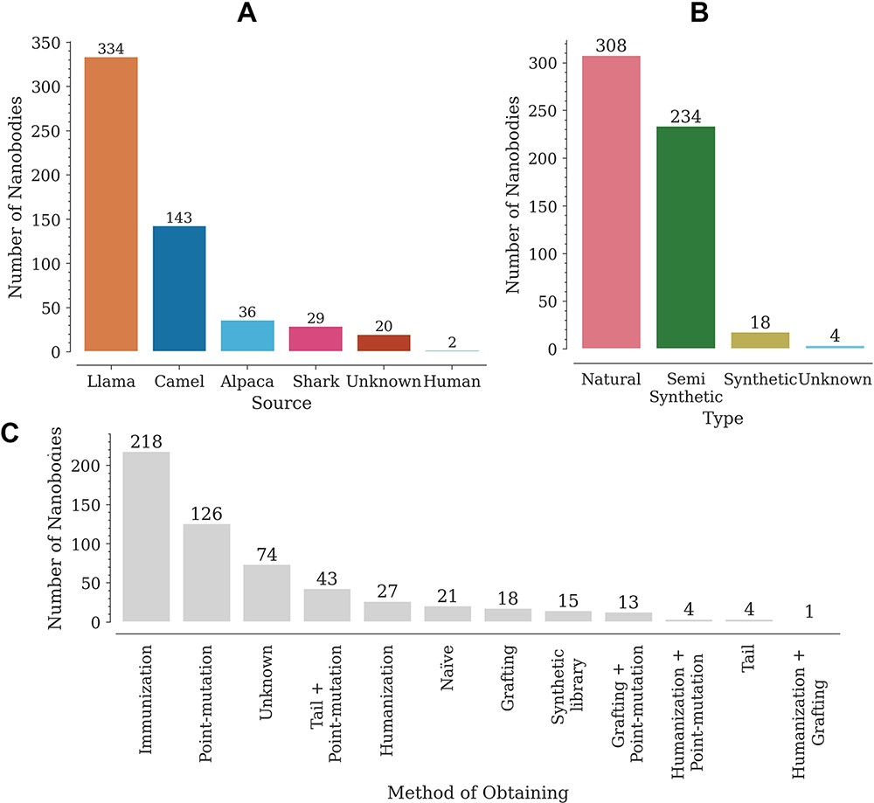
Figure 2. Distribution of Nbs in the database according to (A) source (organism), (B) type and (C) obtaining method.
Notes:
Figure 2. Distribution of Nbs in the database according to (A) source (organism), (B) type and (C) obtaining method.
Unless provided in the caption above, the following copyright applies to the content of this slide: © The Author(s) 2023. Published by Oxford University Press.This is an Open Access article distributed under the terms of the Creative Commons Attribution License (https://creativecommons.org/licenses/by/4.0/), which permits unrestricted reuse, distribution, and reproduction in any medium, provided the original work is properly cited.

Slide 3
Figure 6. Llama and camel consensus Fw sequences for the low- and high-T_{m} groups. The white spaces ...
Notes:
Figure 6. Llama and camel consensus Fw sequences for the low- and high-Tm groups. The white spaces correspond to the three CDRs. Sequence positions differing between the two groups of the same species are marked with an asterisk.
Unless provided in the caption above, the following copyright applies to the content of this slide: © The Author(s) 2023. Published by Oxford University Press.This is an Open Access article distributed under the terms of the Creative Commons Attribution License (https://creativecommons.org/licenses/by/4.0/), which permits unrestricted reuse, distribution, and reproduction in any medium, provided the original work is properly cited.

Slide 4
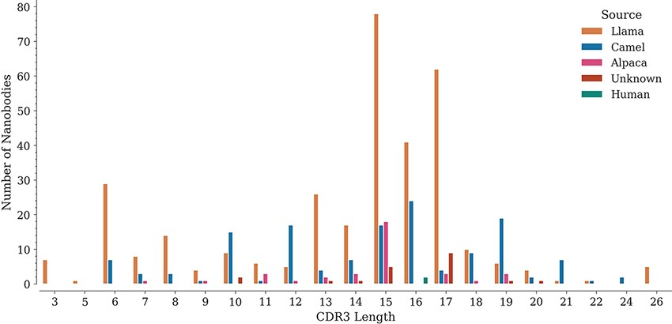
Figure 3. Distribution of CDR3 lengths in the database by source organism.
Notes:
Figure 3. Distribution of CDR3 lengths in the database by source organism.
Unless provided in the caption above, the following copyright applies to the content of this slide: © The Author(s) 2023. Published by Oxford University Press.This is an Open Access article distributed under the terms of the Creative Commons Attribution License (https://creativecommons.org/licenses/by/4.0/), which permits unrestricted reuse, distribution, and reproduction in any medium, provided the original work is properly cited.

Slide 5
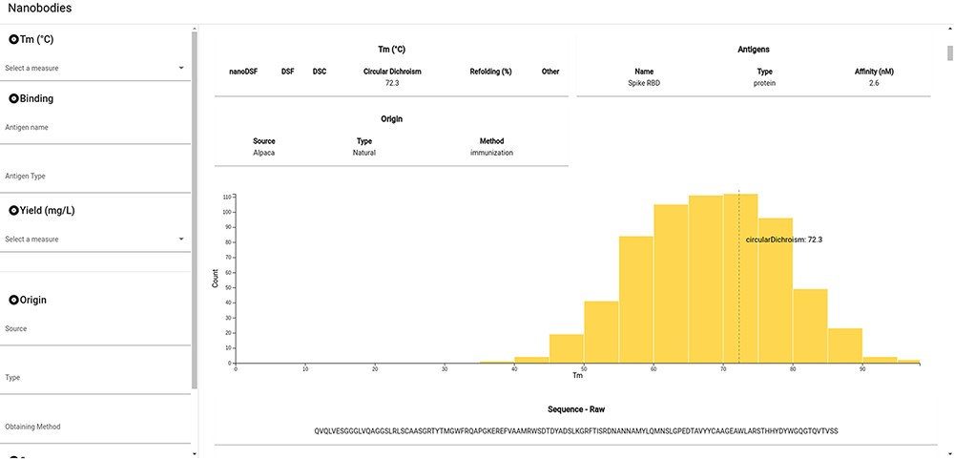
Figure 4. Snapshot of the NbThermo database interface. The left panel contains the annotation filters, while the right ...
Notes:
Figure 4. Snapshot of the NbThermo database interface. The left panel contains the annotation filters, while the right panel displays the selection list and the annotated information corresponding to the selected Nbs.
Unless provided in the caption above, the following copyright applies to the content of this slide: © The Author(s) 2023. Published by Oxford University Press.This is an Open Access article distributed under the terms of the Creative Commons Attribution License (https://creativecommons.org/licenses/by/4.0/), which permits unrestricted reuse, distribution, and reproduction in any medium, provided the original work is properly cited.

Slide 6
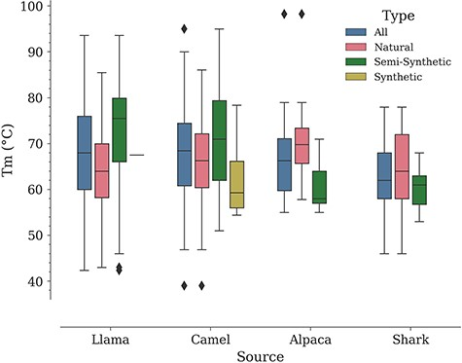
Figure 5. Distribution of T_{m} values by Nb: source and type.
Notes:
Figure 5. Distribution of Tm values by Nb: source and type.
Unless provided in the caption above, the following copyright applies to the content of this slide: © The Author(s) 2023. Published by Oxford University Press.This is an Open Access article distributed under the terms of the Creative Commons Attribution License (https://creativecommons.org/licenses/by/4.0/), which permits unrestricted reuse, distribution, and reproduction in any medium, provided the original work is properly cited.

