Slide 1
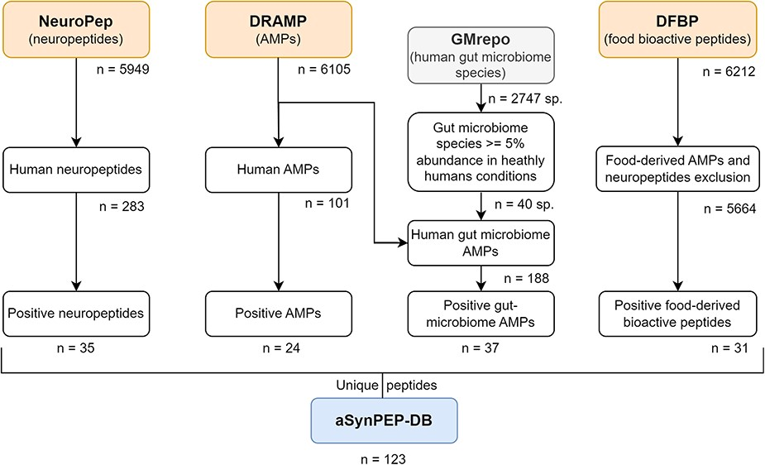
Figure 1. Data curation scheme. Peptides collected in the aSynPEP-DB are obtained from independent source datasets of ...
Notes:
Figure 1. Data curation scheme. Peptides collected in the aSynPEP-DB are obtained from independent source datasets of biogenic peptides. These include human neuropeptides (NeuroPep database), human and human gut microbiome AMPs (DRAMP database) and food-derived bioactive peptides (DFBP database). To select which bacterial species were found in the gut microbiome, the GMrepo database was employed. A total of 123 unique peptides were obtained with the discriminative algorithm.
Unless provided in the caption above, the following copyright applies to the content of this slide: © The Author(s) 2023. Published by Oxford University Press.This is an Open Access article distributed under the terms of the Creative Commons Attribution License (https://creativecommons.org/licenses/by/4.0/), which permits unrestricted reuse, distribution, and reproduction in any medium, provided the original work is properly cited.

Slide 2
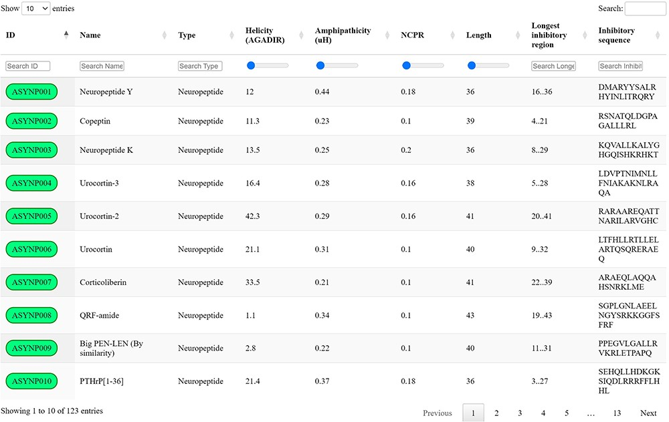
Figure 2. aSynPEP-DB database view. Positive entries are collected in an interactive data table under the ‘Database’ ...
Notes:
Figure 2. aSynPEP-DB database view. Positive entries are collected in an interactive data table under the ‘Database’ tab of the website. Users can perform general searches using the top right text box or by typing under each specific column. For numerical variables, range sliders are provided to filter entries. All columns can be sorted by clicking on the specific header. The number of displayed entries can be modified with the top left selector. Extended peptide details can be accessed by clicking on each peptide identifier.
Unless provided in the caption above, the following copyright applies to the content of this slide: © The Author(s) 2023. Published by Oxford University Press.This is an Open Access article distributed under the terms of the Creative Commons Attribution License (https://creativecommons.org/licenses/by/4.0/), which permits unrestricted reuse, distribution, and reproduction in any medium, provided the original work is properly cited.

Slide 3
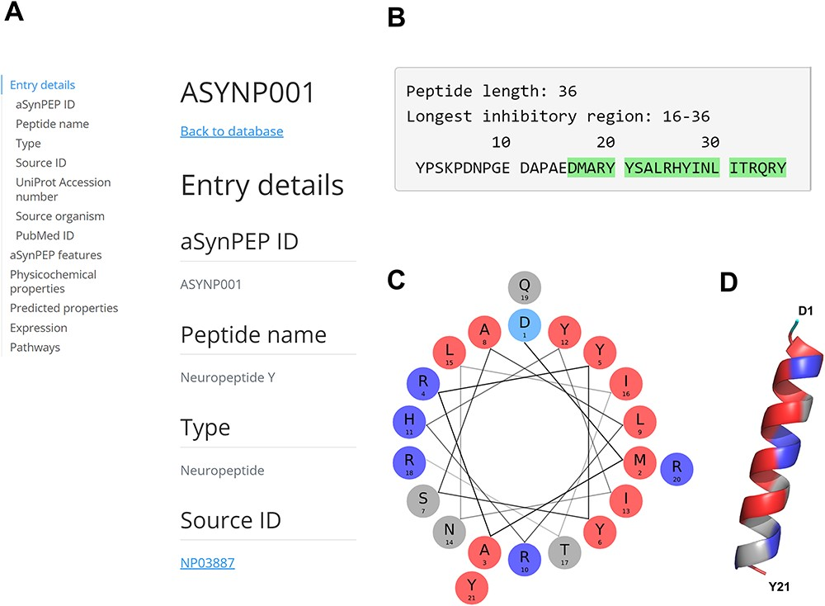
Figure 3. aSynPEP-DB record view for the human neuropeptide Y (ASYNP001). (A) Record view panel showing the information ...
Notes:
Figure 3. aSynPEP-DB record view for the human neuropeptide Y (ASYNP001). (A) Record view panel showing the information provided for each peptide, including entry details, aSynPEP features, physicochemical and predicted properties, expression and pathway information. (B) Peptide sequence with the inhibitory region detected by the discriminative algorithm highlighted in green. (C) Helical wheel representation for the NPY. Hydrophobic and positively charged residues are colored red and dark blue, respectively. (D) Predicted α-helical conformation obtained for the NPY. The structural model was obtained using AlphaFold through ColabFold. The amphipathic character of the helix is visualized with a hydrophobic face (in red) in front of a second cationic face (in dark blue).
Unless provided in the caption above, the following copyright applies to the content of this slide: © The Author(s) 2023. Published by Oxford University Press.This is an Open Access article distributed under the terms of the Creative Commons Attribution License (https://creativecommons.org/licenses/by/4.0/), which permits unrestricted reuse, distribution, and reproduction in any medium, provided the original work is properly cited.

Slide 4
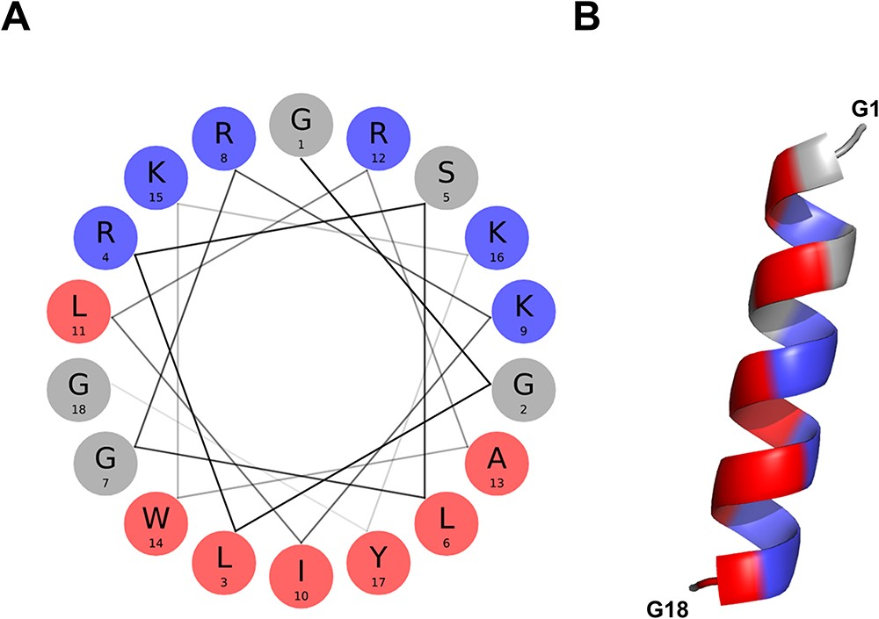
Figure 4. α-helical conformation of the food-derived bioactive BMAP-28 peptide (ASYNP110). (A) Helical wheel ...
Notes:
Figure 4. α-helical conformation of the food-derived bioactive BMAP-28 peptide (ASYNP110). (A) Helical wheel visualization of BMAP-28, which holds the highest amphipathicity of all peptides collected in the database (hydrophobic and cationic residues in red and dark blue, respectively). (B) Predicted α-helical conformation obtained for BMAP-28 (AlphaFold).
Unless provided in the caption above, the following copyright applies to the content of this slide: © The Author(s) 2023. Published by Oxford University Press.This is an Open Access article distributed under the terms of the Creative Commons Attribution License (https://creativecommons.org/licenses/by/4.0/), which permits unrestricted reuse, distribution, and reproduction in any medium, provided the original work is properly cited.

