Slide 1
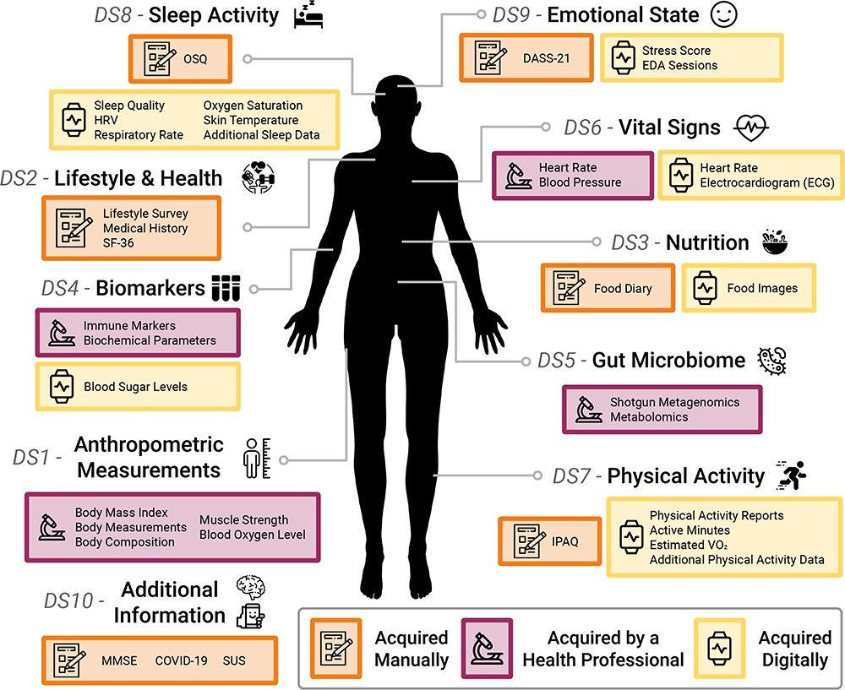
Figure 1. An overview of the AI4FoodDB. The database comprises 10 datasets representing different types of data ...
Notes:
Figure 1. An overview of the AI4FoodDB. The database comprises 10 datasets representing different types of data acquired during the nutritional intervention: Anthropometric Measurements (DS1), Lifestyle and Health (DS2), Nutrition (DS3), Biomarkers (DS4), Gut Microbiome (DS5), Vital Signs (DS6), Physical Activity (DS7), Sleep Activity (DS8), Emotional State (DS9) and Additional Information (DS10). Data acquisition methods are indicated by different colored boxes as well as by icons: manual (depicted with a notebook), clinical (microscope) or digital (smartwatch).
Unless provided in the caption above, the following copyright applies to the content of this slide: © The Author(s) 2023. Published by Oxford University Press.This is an Open Access article distributed under the terms of the Creative Commons Attribution License (https://creativecommons.org/licenses/by/4.0/), which permits unrestricted reuse, distribution, and reproduction in any medium, provided the original work is properly cited.

Slide 2
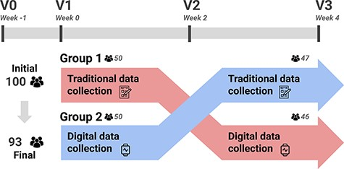
Figure 2. A summary of the acquisition protocol considered in AI4FoodDB. The intervention followed a cross-over design. ...
Notes:
Figure 2. A summary of the acquisition protocol considered in AI4FoodDB. The intervention followed a cross-over design. Participants used a single data collection method for the first 2 weeks (e.g. Group 1 started with traditional data collection) and then switched to the opposite method (in the case of Group 1, digital data collection) for the remaining 2 weeks.
Unless provided in the caption above, the following copyright applies to the content of this slide: © The Author(s) 2023. Published by Oxford University Press.This is an Open Access article distributed under the terms of the Creative Commons Attribution License (https://creativecommons.org/licenses/by/4.0/), which permits unrestricted reuse, distribution, and reproduction in any medium, provided the original work is properly cited.

Slide 3
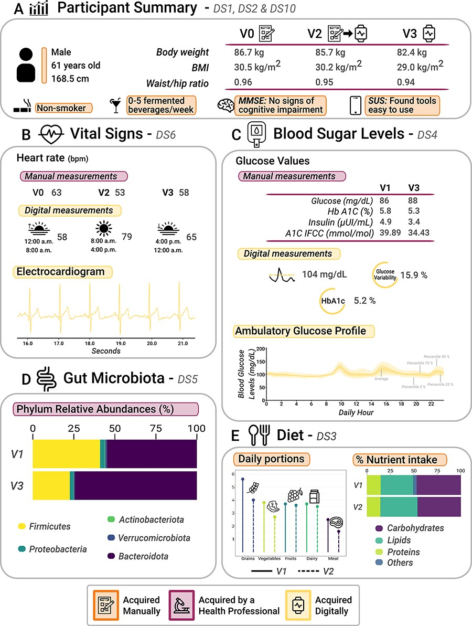
Figure 3.1 Graphical analysis of participant data (a 61-year-old male) collected from AI4FoodDB during the clinical ...
Notes:
Figure 3.1 Graphical analysis of participant data (a 61-year-old male) collected from AI4FoodDB during the clinical intervention. (A) Participant summary, which includes anthropometric measurements from the three visits and additional information (extracted from Datasets 1, 2 and 10). (B) Vital signs associated with manual and digital measurements (Dataset 6). (C) Blood sugar levels, which include manual and digital measurements (Dataset 4). (D) Gut microbiota: relative abundances of the five most abundant phyla at V1 and V3 (Dataset 5). (E) Diet (Dataset 3).
Unless provided in the caption above, the following copyright applies to the content of this slide: © The Author(s) 2023. Published by Oxford University Press.This is an Open Access article distributed under the terms of the Creative Commons Attribution License (https://creativecommons.org/licenses/by/4.0/), which permits unrestricted reuse, distribution, and reproduction in any medium, provided the original work is properly cited.

Slide 4
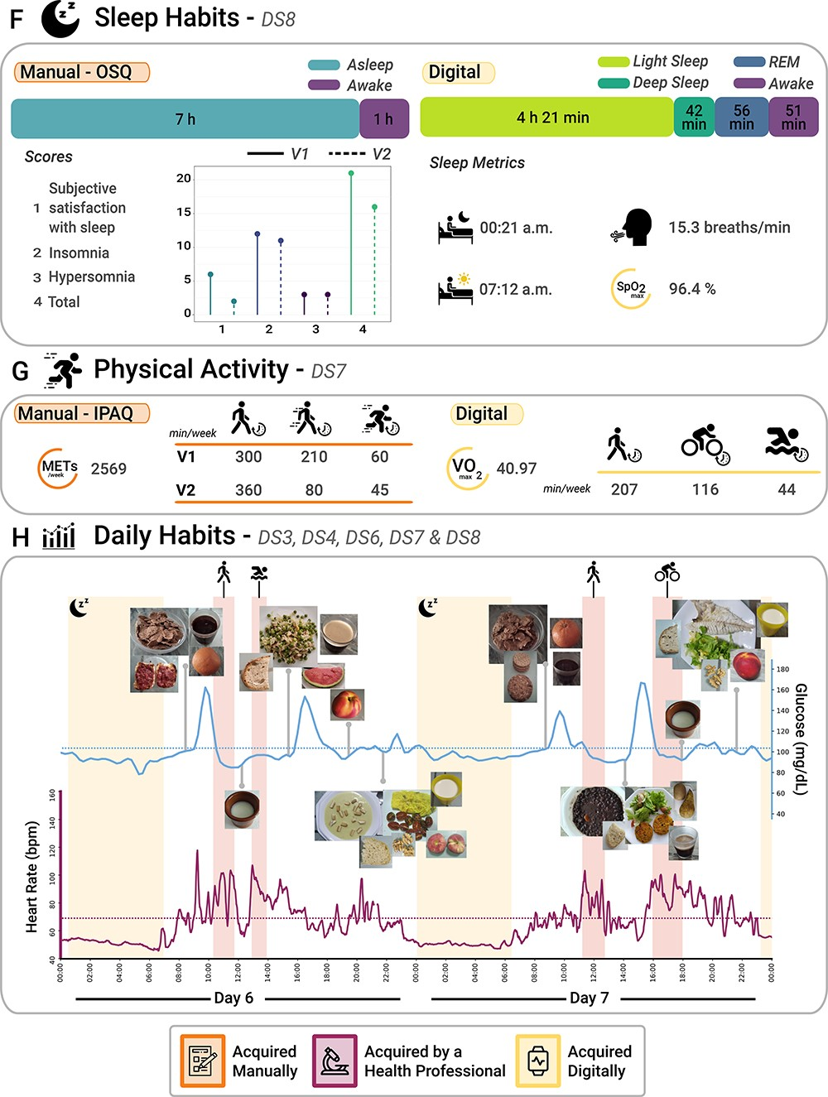
Figure 3.2 Continuing from Figure 3.1. (F) Sleep habits from both subjective (OSQ) and objective (wearable devices) ...
Notes:
Figure 3.2 Continuing from Figure 3.1. (F) Sleep habits from both subjective (OSQ) and objective (wearable devices) perspectives (extracted from Dataset 8). (G) Physical activity from both subjective (IPAQ) and objective (wearable devices) perspectives (Dataset 7). (H) Daily habits, which comprise a 2-day report that includes blood glucose levels, HR, night sleep activity, physical activity and images of the different foods consumed during these 2 days (Datasets 3, 4, 6, 7 and 8).
Unless provided in the caption above, the following copyright applies to the content of this slide: © The Author(s) 2023. Published by Oxford University Press.This is an Open Access article distributed under the terms of the Creative Commons Attribution License (https://creativecommons.org/licenses/by/4.0/), which permits unrestricted reuse, distribution, and reproduction in any medium, provided the original work is properly cited.

