Slide 1
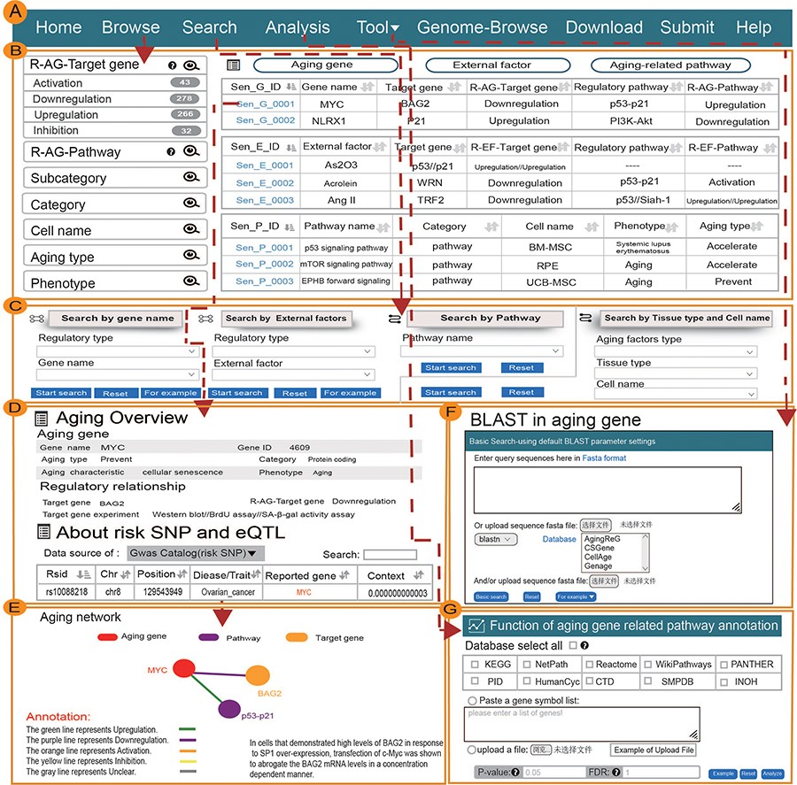
Figure 1. Main function and uses of AgingReG. (A) The top navigation bar helps users use the functions of AgingReG. (B) ...
Notes:
Figure 1. Main function and uses of AgingReG. (A) The top navigation bar helps users use the functions of AgingReG. (B) The snapshot showing the AgingReG browser. (C) Four paths enable searching of specific aging factors and related regulatory relationships. (D) The overview of the details of an aging gene. (E) Target genes potentially associated with aging genes are shown on the basis of five regulatory strategies. Network diagram showing gene–target relationships. (F) BLAST sequences of aging-related genes. (G) Functional annotation of the aging pathway of input data by the hypergeometric test.
Unless provided in the caption above, the following copyright applies to the content of this slide: © The Author(s) 2023. Published by Oxford University Press.This is an Open Access article distributed under the terms of the Creative Commons Attribution License (https://creativecommons.org/licenses/by/4.0/), which permits unrestricted reuse, distribution, and reproduction in any medium, provided the original work is properly cited.

Slide 2
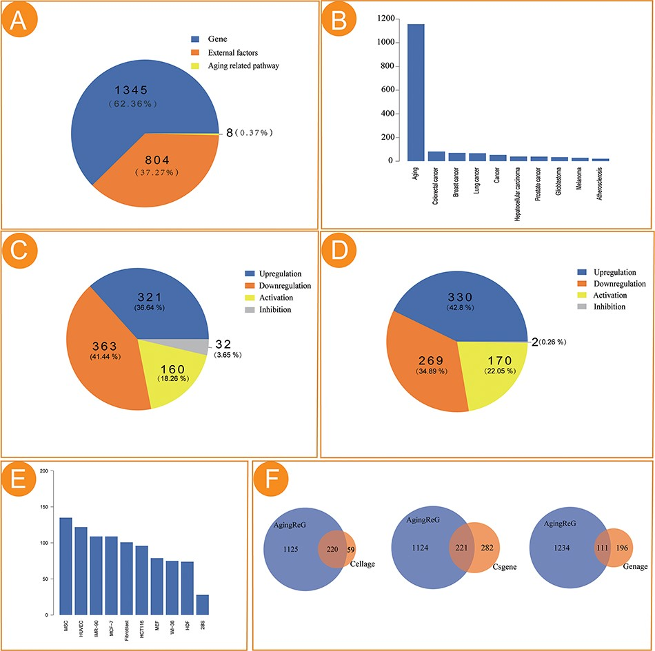
Figure 2. Statistical analysis of the aging factors in AgingReG. (A) The number of aging factors in AgingReG. (B) The ...
Notes:
Figure 2. Statistical analysis of the aging factors in AgingReG. (A) The number of aging factors in AgingReG. (B) The distribution of the pathological phenotypes associated with aging factors in AgingReG. The top 10 extensively studied pathological phenotypes recorded in AgingReG. (C) The number of aging gene–related regulatory relationship entries. (D) The number of external factor–related regulatory relationship entries. (E) The top 10 frequently studied cells in aging research in AgingReG. (F) The comparison between AgingReG and Cellage, between AgingReG and CSGene and between AgingReG and GenAge and the number of overlapping data points.
Unless provided in the caption above, the following copyright applies to the content of this slide: © The Author(s) 2023. Published by Oxford University Press.This is an Open Access article distributed under the terms of the Creative Commons Attribution License (https://creativecommons.org/licenses/by/4.0/), which permits unrestricted reuse, distribution, and reproduction in any medium, provided the original work is properly cited.

