Slide 1
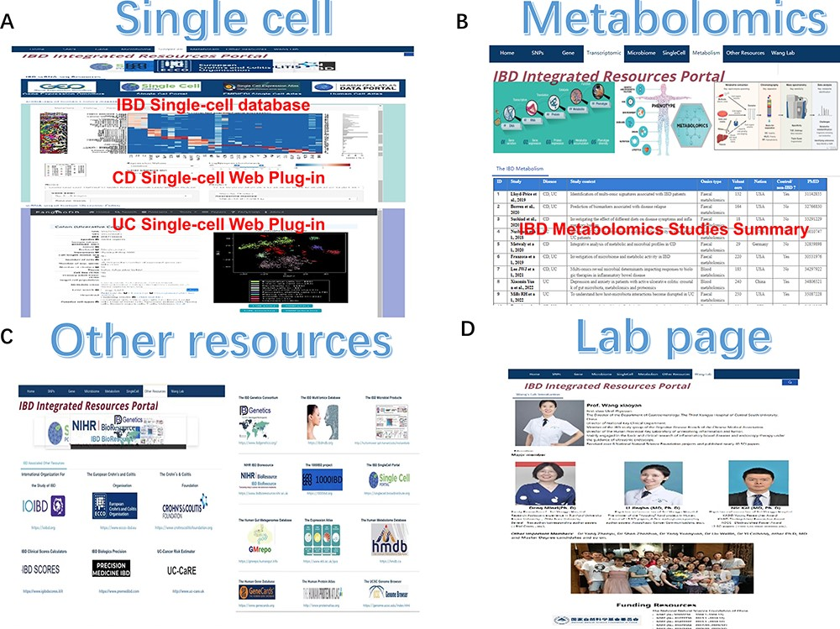
Figure 3. The single-cell, metabolomics, other resources and lab page section of IBDIRP. (A) The single-cell section ...
Notes:
Figure 3. The single-cell, metabolomics, other resources and lab page section of IBDIRP. (A) The single-cell section exhibited major IBD-related database and introduced IBD single-cell interactive visualization. (B) More than 24 primary recently published large-scale IBD metabolomics studies are displayed in the metabolomics section. (C) The other research resource listed 18 important IBD web resources. (D) The lab page introduces our lab briefly. Alt Text: The brief introduction of single-cell, metabolomics, other resources and lab page section in IBDIRP website.
Unless provided in the caption above, the following copyright applies to the content of this slide: © The Author(s) 2024. Published by Oxford University Press.This is an Open Access article distributed under the terms of the Creative Commons Attribution License (https://creativecommons.org/licenses/by/4.0/), which permits unrestricted reuse, distribution, and reproduction in any medium, provided the original work is properly cited.

