Slide 1
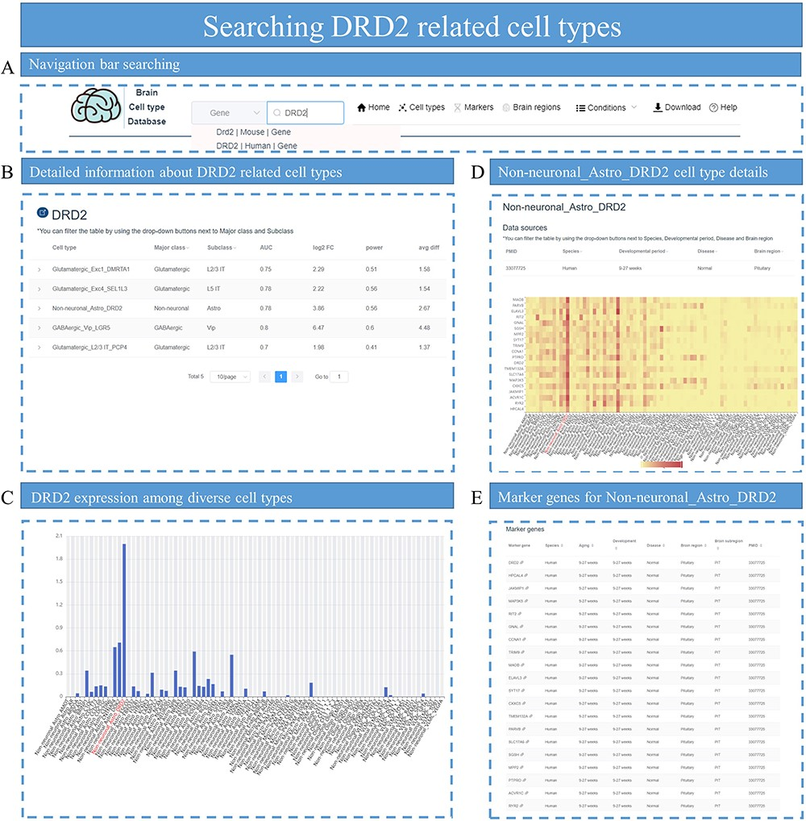
Figure 6. Identifying DRD2-related cell types. (A) Search for DRD2 in the search box of the homepage. (B) All cell ...
Notes:
Figure 6. Identifying DRD2-related cell types. (A) Search for DRD2 in the search box of the homepage. (B) All cell types related to DRD2 are displayed, with parameters associated with DEGs such as log2 FC and power value. (C) Bar plot shows the distribution of DRD2 expression among cell types in that specific dataset. (D) The heatmap plot for top DEG expression distribution is displayed for cell-type Non-neuronal_Astro_DRD2. (E) All the top marker genes for cell-type Non-neuronal_Astro_DRD2 are provided.
Unless provided in the caption above, the following copyright applies to the content of this slide: © The Author(s) 2023. Published by Oxford University Press.This is an Open Access article distributed under the terms of the Creative Commons Attribution License (https://creativecommons.org/licenses/by/4.0/), which permits unrestricted reuse, distribution, and reproduction in any medium, provided the original work is properly cited.

