Slide 1
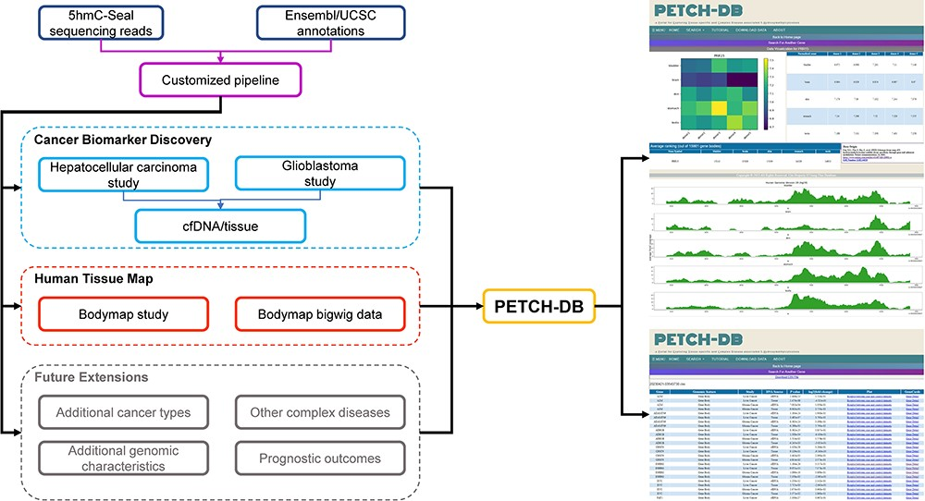
Figure 1. Overview of the database contents. The PETCH-DB (v1.0) aims to be a centralized portal for published ...
Notes:
Figure 1. Overview of the database contents. The PETCH-DB (v1.0) aims to be a centralized portal for published 5hmC-Seal results processed by the previously published bioinformatic pipelines in primarily clinical samples. The figure shows two major data resources for Cancer Biomarker Discovery and Human Tissue Map (i.e. bodymap) and the Future Extensions as well.
Unless provided in the caption above, the following copyright applies to the content of this slide: © The Author(s) 2023. Published by Oxford University Press.This is an Open Access article distributed under the terms of the Creative Commons Attribution License (https://creativecommons.org/licenses/by/4.0/), which permits unrestricted reuse, distribution, and reproduction in any medium, provided the original work is properly cited.

