Slide 1
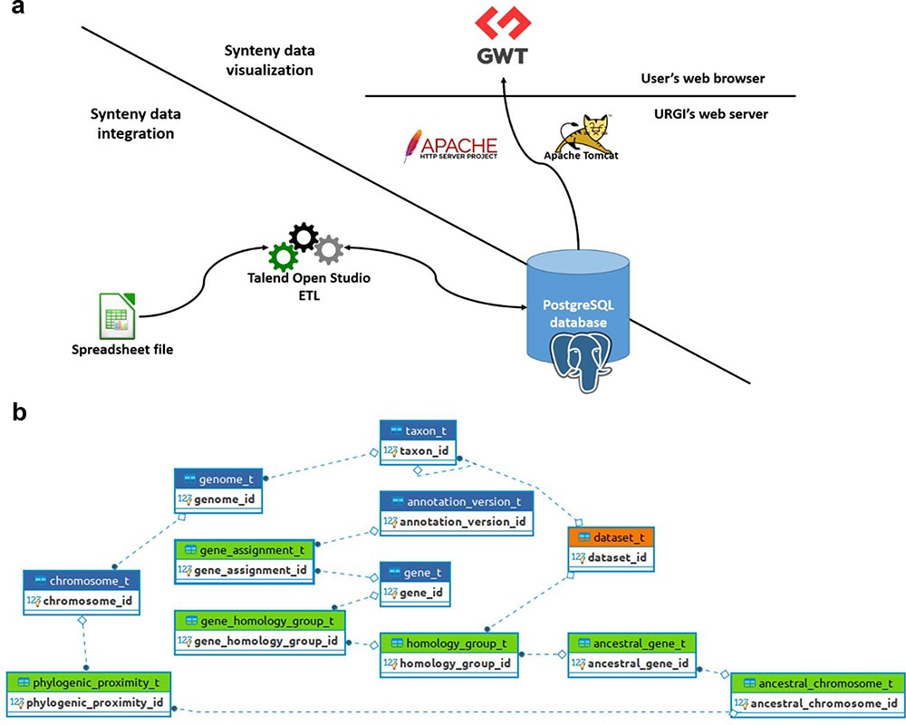
Figure 2. SyntenyViewer data processing and database description. (a) Illustration of theSyntenyViewer architecture ...
Notes:
Figure 2. SyntenyViewer data processing and database description. (a) Illustration of theSyntenyViewer architecture including the data integration step into a PostgreSQL instance, and the data visualization based on GWT powered by Apache Tomcat and Apache HTTP server. (b) Illustration of the SyntenyViewer database model with for each box a table named with its primary key term (referenced below). Tables colored in green store data in an append only fashion when a new synteny dataset is submitted, blue tables contain new data as well as data shared between different datasets, orange table stores new data as well as updated data from a previously inserted dataset (i.e. ‘dataset_t’ that handles several versions of a dataset: a new tuple is inserted for Version 2 of Dataset A, while the tuple with Version 1 is marked obsolete). Some technical relationships between tables have been hidden for clarity. The database is structured below. ‘Table dataset_t’: this contains information about each dataset (name, version, DOI). ‘Table gene_assignment_t’: this contains genomic information of a gene (position, strand, phase…). ‘Table homology_group_t’: this represents a group of conserved genes. ‘Table gene_homology_group_t’: this makes the link between a gene and its orthologous groups.‘Table ancestral_gene_t’: this contains the information of PGs.‘Table ancestral_chromosome_t’: this stores the reconstructed protochromosomes‘Table phylogenic_proximity_t’: this allows us to store the evolutionary distance between a reconstructed protochromosome and its descendant (modern) chromosomes
Unless provided in the caption above, the following copyright applies to the content of this slide: © The Author(s) 2023. Published by Oxford University Press.This is an Open Access article distributed under the terms of the Creative Commons Attribution License (https://creativecommons.org/licenses/by/4.0/), which permits unrestricted reuse, distribution, and reproduction in any medium, provided the original work is properly cited.

