Slide 1
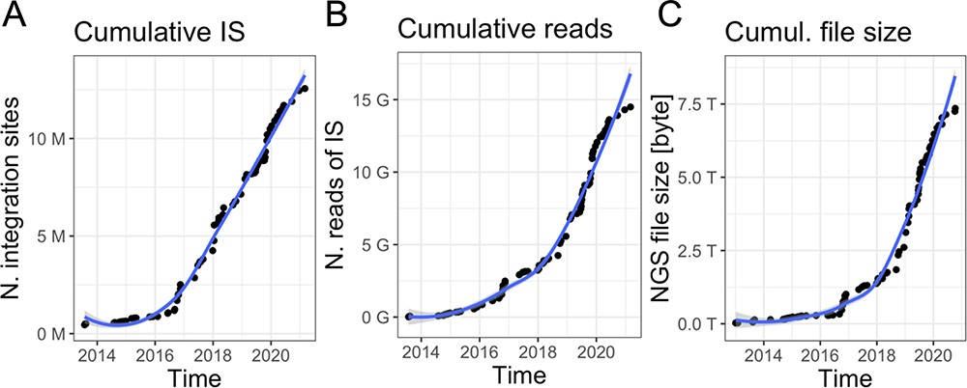
Figure 1. Data volume of clonal tracking studies in clinical trials for gene therapy applications at SR-Tiget by (A) ...
Notes:
Figure 1. Data volume of clonal tracking studies in clinical trials for gene therapy applications at SR-Tiget by (A) integration sites, (B) sequencing reads of IS and (C) NGS file size (sequencing pools from several technologies). ‘Number of reads’ refers to the overall number of sequencing reads; ‘Number of IS’ refers to the number of integration sites identified in the samples, corresponding to clones. ‘File size’ corresponds to the size of the files of the NGS pools (gzip compression).
Unless provided in the caption above, the following copyright applies to the content of this slide: © The Author(s) 2023. Published by Oxford University Press.This is an Open Access article distributed under the terms of the Creative Commons Attribution License (https://creativecommons.org/licenses/by/4.0/), which permits unrestricted reuse, distribution, and reproduction in any medium, provided the original work is properly cited.

