Slide 1
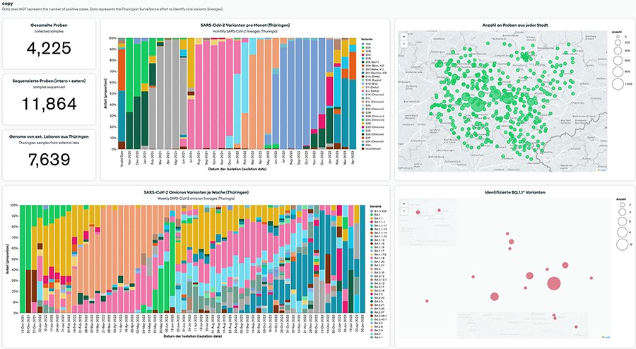
Figure 3. MongoDB Charts dashboard example based on the Thuringian Surveillance Effort for SARS-CoV-2 genomic ...
Notes:
Figure 3. MongoDB Charts dashboard example based on the Thuringian Surveillance Effort for SARS-CoV-2 genomic sequencing. MongoDB Charts are accessible at https://www.bit.ly/3MtK2v2.
Unless provided in the caption above, the following copyright applies to the content of this slide: © The Author(s) 2023. Published by Oxford University Press.This is an Open Access article distributed under the terms of the Creative Commons Attribution License (https://creativecommons.org/licenses/by/4.0/), which permits unrestricted reuse, distribution, and reproduction in any medium, provided the original work is properly cited.

