Slide 1
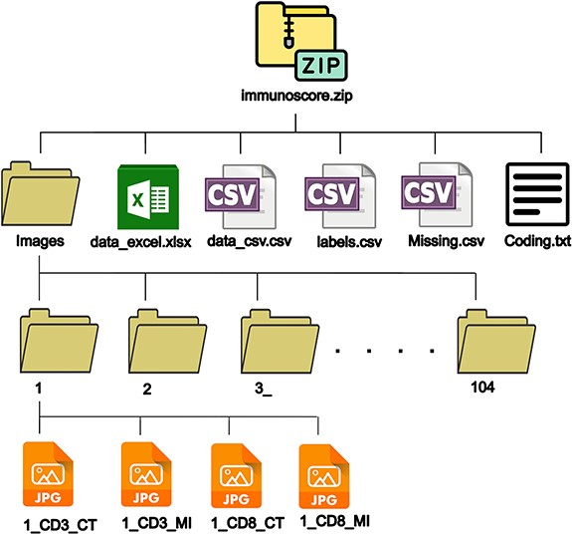
Figure 1. Dataset structure.
Notes:
Figure 1. Dataset structure. Alt text: The structure of files and folders in the main zip file.
Unless provided in the caption above, the following copyright applies to the content of this slide: © The Author(s) 2023. Published by Oxford University Press.This is an Open Access article distributed under the terms of the Creative Commons Attribution License (https://creativecommons.org/licenses/by/4.0/), which permits unrestricted reuse, distribution, and reproduction in any medium, provided the original work is properly cited.

Slide 2
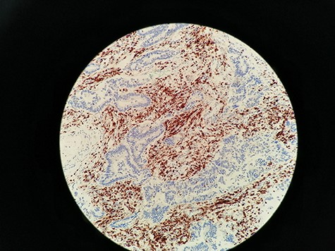
Figure 2. Immunohistochemistry staining for CD3+ TILs in 60_CD3_CT image. CD3 lymphocytes in CT are highlighted.
Notes:
Figure 2. Immunohistochemistry staining for CD3+ TILs in 60_CD3_CT image. CD3 lymphocytes in CT are highlighted. Alt text: CD3 lymphocytes are marked with brown using immunohistochemistery.
Unless provided in the caption above, the following copyright applies to the content of this slide: © The Author(s) 2023. Published by Oxford University Press.This is an Open Access article distributed under the terms of the Creative Commons Attribution License (https://creativecommons.org/licenses/by/4.0/), which permits unrestricted reuse, distribution, and reproduction in any medium, provided the original work is properly cited.

Slide 3
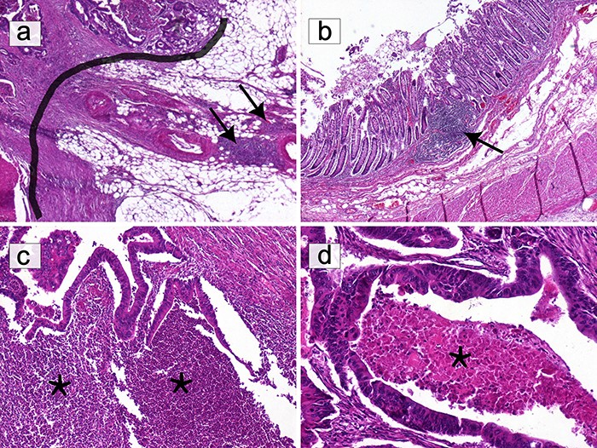
Figure 3. Selection of areas for T-cell quantification on HE slides. (a) Only T lymphocytes in direct contact with the ...
Notes:
Figure 3. Selection of areas for T-cell quantification on HE slides. (a) Only T lymphocytes in direct contact with the IM (black border) were quantified. Lymphocytic infiltration beyond the IM, including lymphoid nodules (black arrows), was excluded (HE ×40). (b) Submucosal lymphoid follicles (black arrows) were not included in the count (HE ×40). (c) The infiltrate composed of granulocytes in abscessed areas (*) was not considered (HE ×100). (d) Areas of ‘necrosis’ (*) were not taken into consideration (HE ×200). Alt text: HE slides highlighting areas to select or avoid for T-cell quantification.
Unless provided in the caption above, the following copyright applies to the content of this slide: © The Author(s) 2023. Published by Oxford University Press.This is an Open Access article distributed under the terms of the Creative Commons Attribution License (https://creativecommons.org/licenses/by/4.0/), which permits unrestricted reuse, distribution, and reproduction in any medium, provided the original work is properly cited.

Slide 4
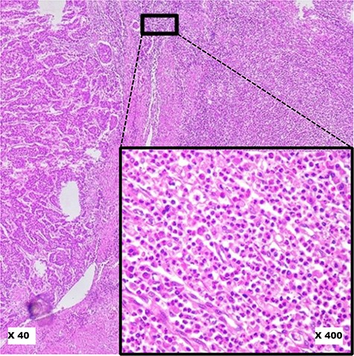
Figure 4. Pitfalls to avoid in selecting ‘Hot Spot’ areas on HE slides. This image shows a robust inflammatory response ...
Notes:
Figure 4. Pitfalls to avoid in selecting ‘Hot Spot’ areas on HE slides. This image shows a robust inflammatory response in the tumour microenvironment at low magnification (×40). At higher magnification (×400), it reveals a polymorphic inflammatory infiltrate particularly rich in neutrophilic granulocytes, which should not be considered. Alt text: Polymorphic inflammatory infiltrate rich in neutrophilic granulocytes, to avoid when selecting hot spots.
Unless provided in the caption above, the following copyright applies to the content of this slide: © The Author(s) 2023. Published by Oxford University Press.This is an Open Access article distributed under the terms of the Creative Commons Attribution License (https://creativecommons.org/licenses/by/4.0/), which permits unrestricted reuse, distribution, and reproduction in any medium, provided the original work is properly cited.

Slide 5
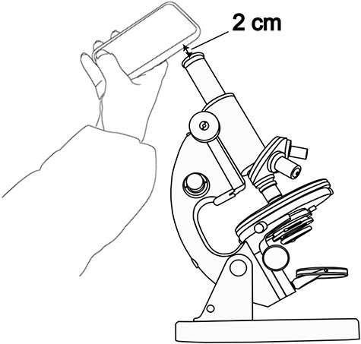
Figure 5. The photo-taking method.
Notes:
Figure 5. The photo-taking method. Alt text: The photo-taking method using a smartphone on top of the microscope’s ocular.
Unless provided in the caption above, the following copyright applies to the content of this slide: © The Author(s) 2023. Published by Oxford University Press.This is an Open Access article distributed under the terms of the Creative Commons Attribution License (https://creativecommons.org/licenses/by/4.0/), which permits unrestricted reuse, distribution, and reproduction in any medium, provided the original work is properly cited.

Slide 6
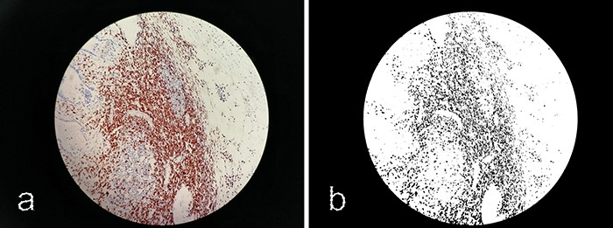
Figure 6. Processing images with ImageJ. (a) Original image 60_CD3_IM.jpg. (b) Processed image using ImageJ software.
Notes:
Figure 6. Processing images with ImageJ. (a) Original image 60_CD3_IM.jpg. (b) Processed image using ImageJ software. Alt text: Processing images with ImageJ software using thresholding to show only stained cells.
Unless provided in the caption above, the following copyright applies to the content of this slide: © The Author(s) 2023. Published by Oxford University Press.This is an Open Access article distributed under the terms of the Creative Commons Attribution License (https://creativecommons.org/licenses/by/4.0/), which permits unrestricted reuse, distribution, and reproduction in any medium, provided the original work is properly cited.

Slide 7
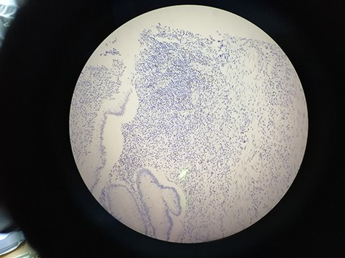
Figure 7. 15_CD8_IM showing the deviation from the central alignment.
Notes:
Figure 7. 15_CD8_IM showing the deviation from the central alignment. Alt text: Deviation from the central alignment showing the background.
Unless provided in the caption above, the following copyright applies to the content of this slide: © The Author(s) 2023. Published by Oxford University Press.This is an Open Access article distributed under the terms of the Creative Commons Attribution License (https://creativecommons.org/licenses/by/4.0/), which permits unrestricted reuse, distribution, and reproduction in any medium, provided the original work is properly cited.

