Slide 1
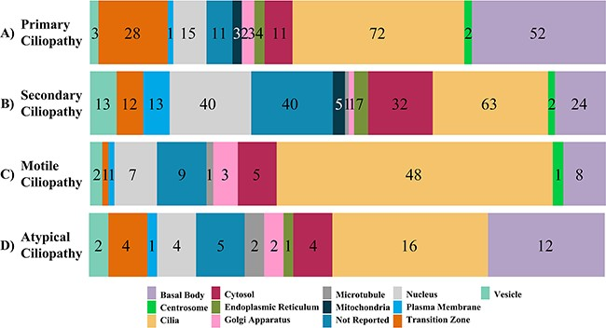
Figure 2. The subcellular localization of ciliopathy disease genes within cells is displayed. Numbers in the bar graph ...
Notes:
Figure 2. The subcellular localization of ciliopathy disease genes within cells is displayed. Numbers in the bar graph demonstrate how the proteins encoded by the primary, secondary and atypical ciliopathies-causing genes are localized throughout the cell.
Unless provided in the caption above, the following copyright applies to the content of this slide: © The Author(s) 2023. Published by Oxford University Press.This is an Open Access article distributed under the terms of the Creative Commons Attribution License (https://creativecommons.org/licenses/by/4.0/), which permits unrestricted reuse, distribution, and reproduction in any medium, provided the original work is properly cited.

