Slide 1
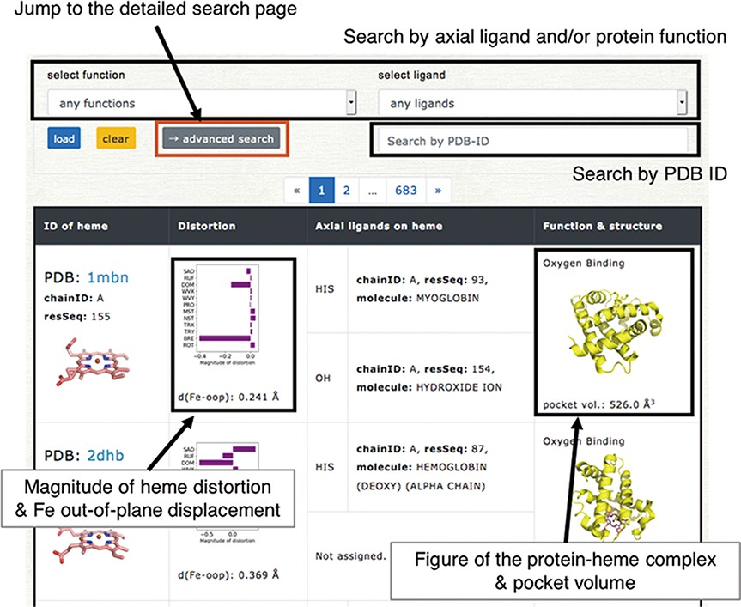
Figure 5. Browser in PyDISH. Select the axial ligand and protein function or enter a PDB ID, and click the ‘load’ ...
Notes:
Figure 5. Browser in PyDISH. Select the axial ligand and protein function or enter a PDB ID, and click the ‘load’ button, and then the relevant data will be listed. The images can be enlarged by hovering the mouse cursor over each item.
Unless provided in the caption above, the following copyright applies to the content of this slide: © The Author(s) 2020. Published by Oxford University Press.This is an Open Access article distributed under the terms of the Creative Commons Attribution License (http://creativecommons.org/licenses/by/4.0/), which permits unrestricted reuse, distribution, and reproduction in any medium, provided the original work is properly cited.

