Slide 1
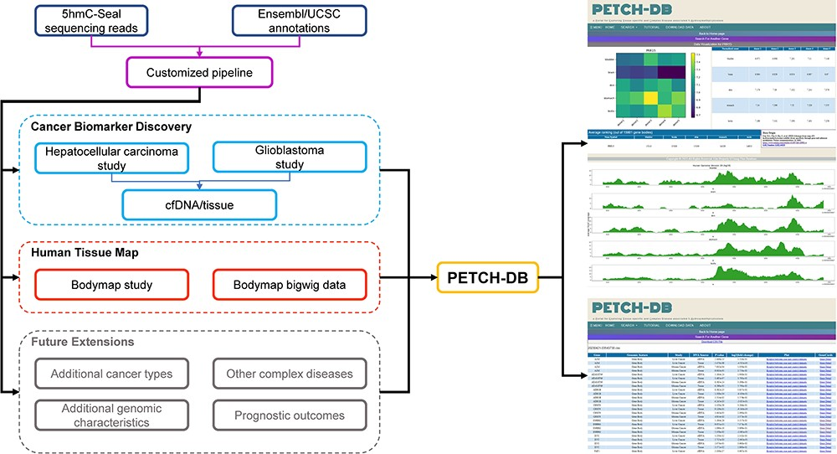
Figure 1. Overview of the database contents. The PETCH-DB (v1.0) aims to be a centralized portal for published ...
Notes:
Figure 1. Overview of the database contents. The PETCH-DB (v1.0) aims to be a centralized portal for published 5hmC-Seal results processed by the previously published bioinformatic pipelines in primarily clinical samples. The figure shows two major data resources for Cancer Biomarker Discovery and Human Tissue Map (i.e. bodymap) and the Future Extensions as well.
Unless provided in the caption above, the following copyright applies to the content of this slide: © The Author(s) 2023. Published by Oxford University Press.This is an Open Access article distributed under the terms of the Creative Commons Attribution License (https://creativecommons.org/licenses/by/4.0/), which permits unrestricted reuse, distribution, and reproduction in any medium, provided the original work is properly cited.

Slide 2
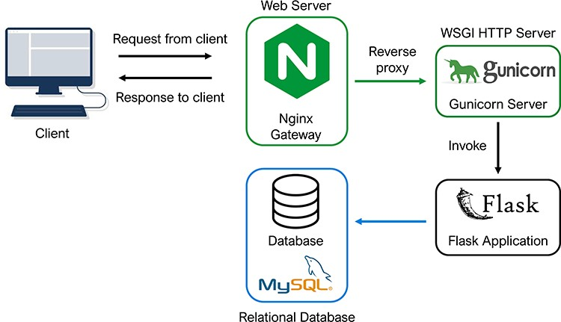
Figure 2. Database architecture and programming. The architectural flow of the PETCH-DB is shown. NGINX and Gunicorn ...
Notes:
Figure 2. Database architecture and programming. The architectural flow of the PETCH-DB is shown. NGINX and Gunicorn are used to provide a server gateway interface to the flask application, which transmits requests to the MySQL database, thus offering a flexible framework for future expansion of the database.
Unless provided in the caption above, the following copyright applies to the content of this slide: © The Author(s) 2023. Published by Oxford University Press.This is an Open Access article distributed under the terms of the Creative Commons Attribution License (https://creativecommons.org/licenses/by/4.0/), which permits unrestricted reuse, distribution, and reproduction in any medium, provided the original work is properly cited.

Slide 3
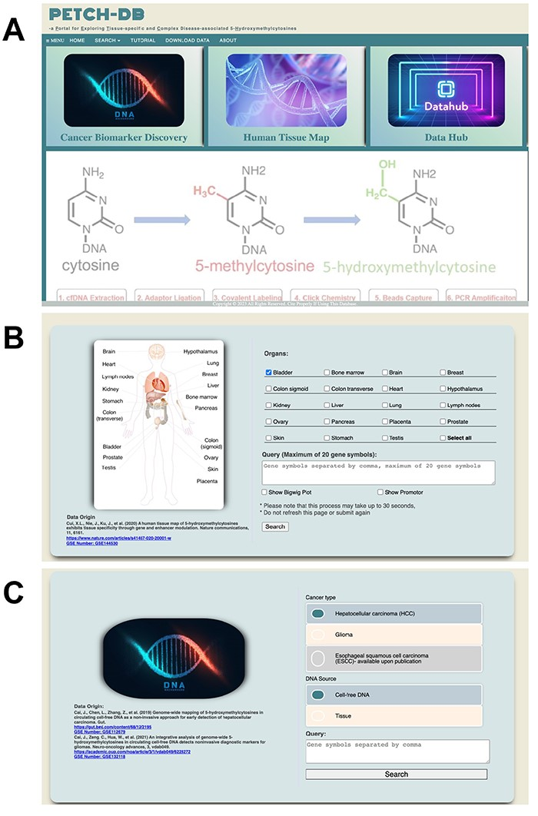
Figure 3. User interfaces. Screenshots are showcased for (A) the main interface, (B) Human Tissue Map and (C) Cancer ...
Notes:
Figure 3. User interfaces. Screenshots are showcased for (A) the main interface, (B) Human Tissue Map and (C) Cancer Biomarker Discovery.
Unless provided in the caption above, the following copyright applies to the content of this slide: © The Author(s) 2023. Published by Oxford University Press.This is an Open Access article distributed under the terms of the Creative Commons Attribution License (https://creativecommons.org/licenses/by/4.0/), which permits unrestricted reuse, distribution, and reproduction in any medium, provided the original work is properly cited.

Slide 4
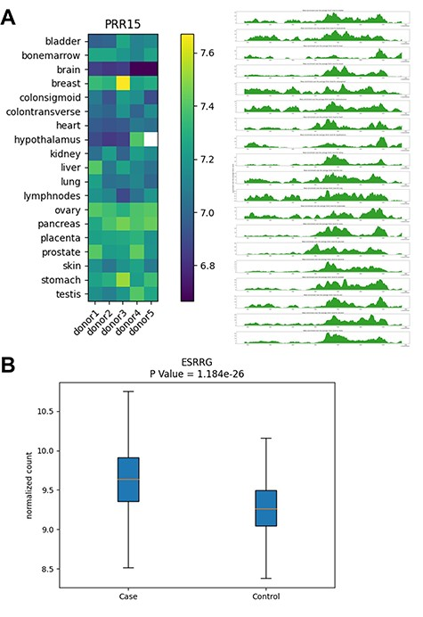
Figure 4. Examples of database outputs. Examples of database outputs are showcased for (A) Human Tissue Map: the PRR15 ...
Notes:
Figure 4. Examples of database outputs. Examples of database outputs are showcased for (A) Human Tissue Map: the PRR15 gene shows brain-specific 5hmC modification, compared with various tissue types and (B) Cancer Biomarker Discovery: the ESRRG gene shows higher 5hmC level in liver cancer patients relative to controls from a liver cancer study.
Unless provided in the caption above, the following copyright applies to the content of this slide: © The Author(s) 2023. Published by Oxford University Press.This is an Open Access article distributed under the terms of the Creative Commons Attribution License (https://creativecommons.org/licenses/by/4.0/), which permits unrestricted reuse, distribution, and reproduction in any medium, provided the original work is properly cited.

