Slide 1
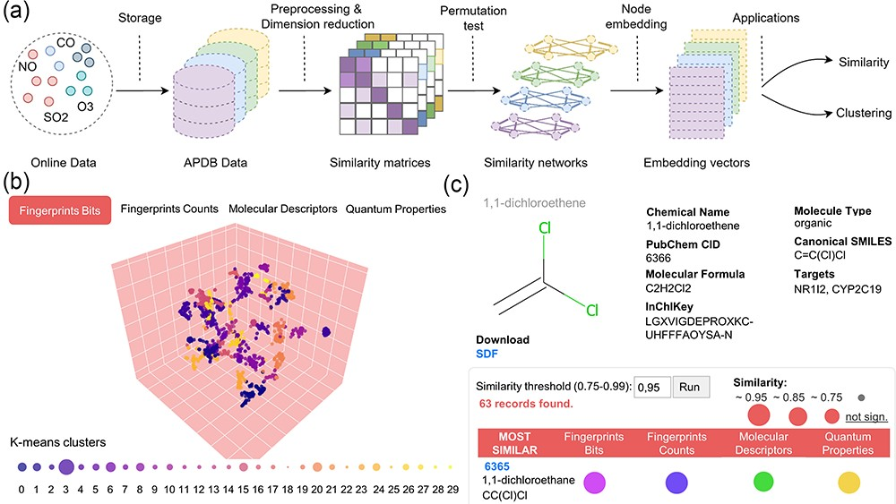
Figure 2. Data preprocessing and similarity analysis. (a) From data collection and storage to data preprocessing and ...
Notes:
Figure 2. Data preprocessing and similarity analysis. (a) From data collection and storage to data preprocessing and similarity calculation. (b) k-means clustering of similarity spaces. (c) The panel of similar molecules to a query molecule (default threshold is 0.95; if no similar molecules are found, those with the closest threshold are returned).
Unless provided in the caption above, the following copyright applies to the content of this slide: © The Author(s) 2023. Published by Oxford University Press.This is an Open Access article distributed under the terms of the Creative Commons Attribution License (https://creativecommons.org/licenses/by/4.0/), which permits unrestricted reuse, distribution, and reproduction in any medium, provided the original work is properly cited.

