Slide 1
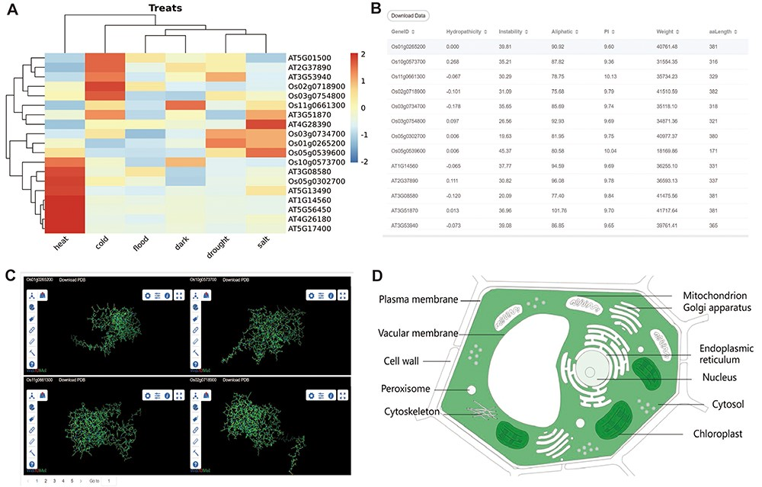
Figure 3. The other part of downstream analysis modules about transcriptome and proteome. (A) Expression module, gene ...
Notes:
Figure 3. The other part of downstream analysis modules about transcriptome and proteome. (A) Expression module, gene expression in heat, cold, flood, dark, drought and salt conditions visualized by heatmap. (B) Physicochemical properties modules with PI, hydropathicity, Aliphatic, Instability, Weight and amino acids length. (C) 3D-Model module presenting four 3D structures at once. The ID and download are at the top of each structure. (D) Subcell modules with dark part meaning more genes localized there.
Unless provided in the caption above, the following copyright applies to the content of this slide: © The Author(s) 2023. Published by Oxford University Press.This is an Open Access article distributed under the terms of the Creative Commons Attribution License (https://creativecommons.org/licenses/by/4.0/), which permits unrestricted reuse, distribution, and reproduction in any medium, provided the original work is properly cited.

