Slide 1
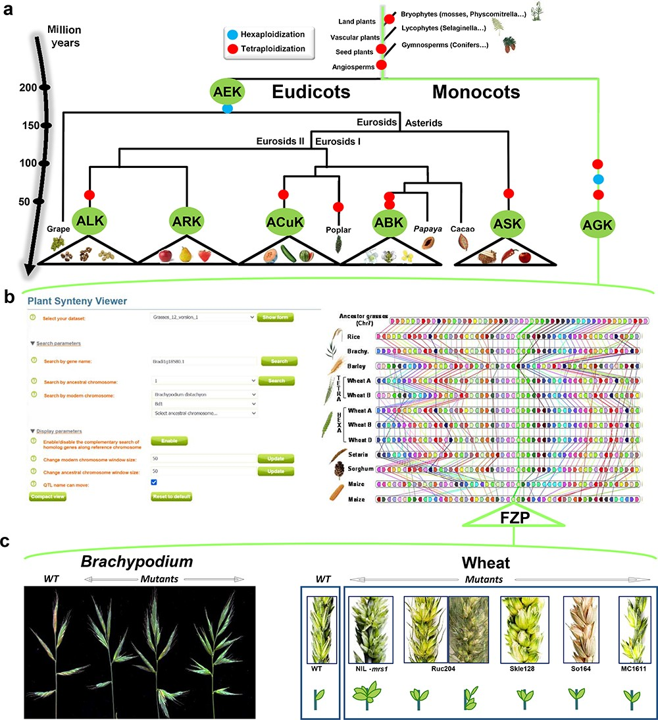
Figure 3. SyntenyViewer, a comparative genomics-driven translational research tool. (a) ‘Plant genome evolution from ...
Notes:
Figure 3. SyntenyViewer, a comparative genomics-driven translational research tool. (a) ‘Plant genome evolution from reconstructed ancestors’. The present-day angiosperm species (bottom) are represented along the evolutionary tree of the Angiosperms from founder ancestors (AGK, AEK, AcuK, ASK, ARK, ABK and ALK) of major botanical families with the time scale shown on the left (in million years). The polyploidization events that have shaped the structure of modern plant genomes during their evolution from inferred ancestors are indicated by red dots (duplication) and blue dots (triplication). (b) ‘SyntenyViewer screen capture’. SyntenyViewer tool with the setting parameters (search by gene name and ancestral or modern chromosomes) illustrated at the left and the derived comparative genomics data visualization, as detailed in the text, at the right (here for cereals). Genes are illustrated as colored boxes for each species (in lines), so that conserved genes are linked with colored lines between species. (c) ‘Synteny-based translational research of FZP gene in grasses’. FZP gene characterization in grasses with orthologs from SyntenyViewer (Panel b) and functional validation in wheat and Brachypodium (in mutants compared to wild type) in deriving similar SS phenotypes (adapted from (47)).
Unless provided in the caption above, the following copyright applies to the content of this slide: © The Author(s) 2023. Published by Oxford University Press.This is an Open Access article distributed under the terms of the Creative Commons Attribution License (https://creativecommons.org/licenses/by/4.0/), which permits unrestricted reuse, distribution, and reproduction in any medium, provided the original work is properly cited.

