Slide 1
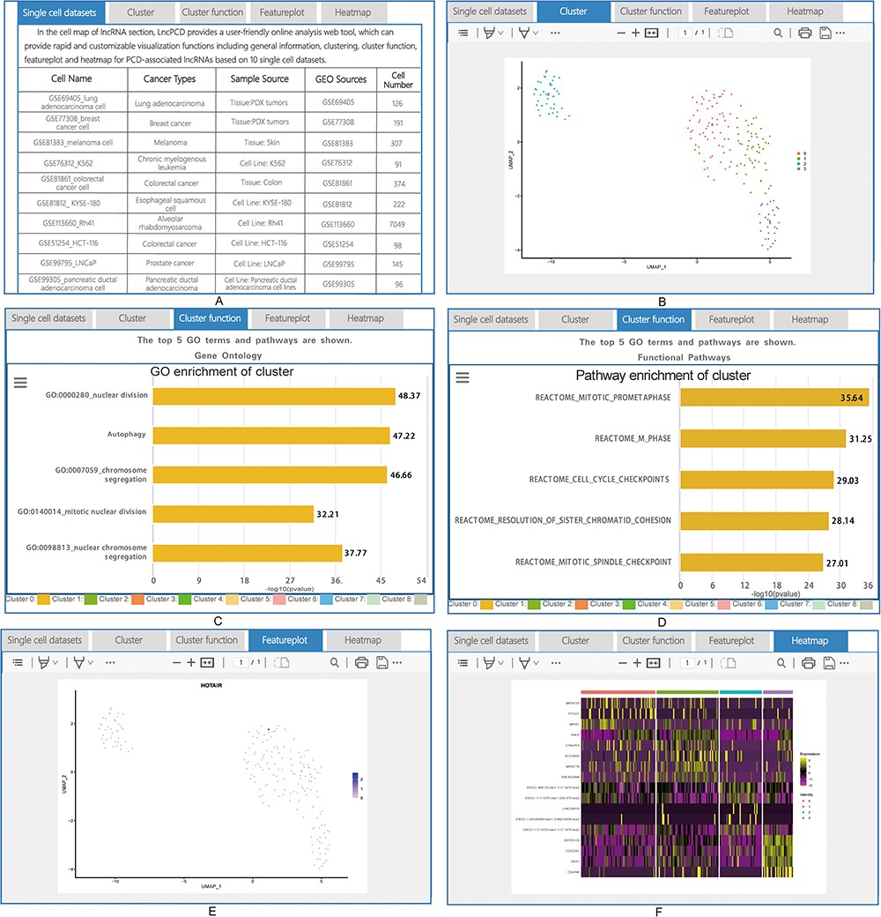
Figure 6. Detailed information for cell map of lncRNA. (A) General information for the single-cell sequencing data. (B) ...
Notes:
Figure 6. Detailed information for cell map of lncRNA. (A) General information for the single-cell sequencing data. (B) Cluster plot of lncRNAs based on single-cell sequencing data. (C) A plot of the GO enrichment of cluster. (D) A plot of the pathway enrichment of cluster. (E) Feature plot of lncRNAs based on single-cell sequencing data. (F) Heatmap plot of lncRNAs based on single-cell sequencing data.
Unless provided in the caption above, the following copyright applies to the content of this slide: © The Author(s) 2023. Published by Oxford University Press.This is an Open Access article distributed under the terms of the Creative Commons Attribution License (https://creativecommons.org/licenses/by/4.0/), which permits unrestricted reuse, distribution, and reproduction in any medium, provided the original work is properly cited.

