Slide 1
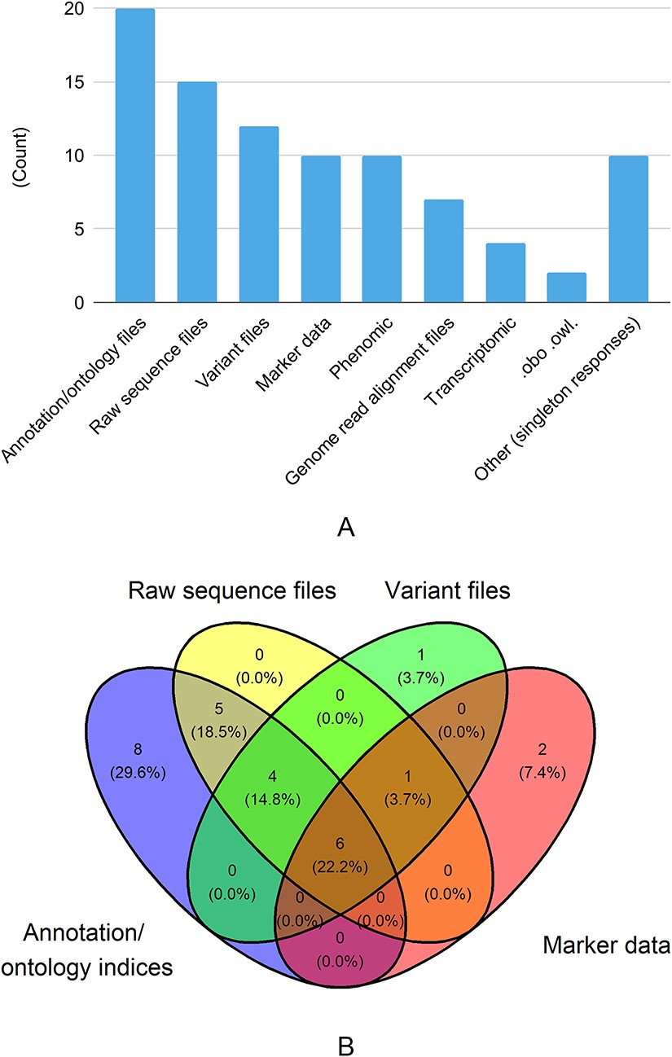
Figure 3. Data types shared with other databases. There were 29 responses to this question. In Figure 3A, singleton ...
Notes:
Figure 3. Data types shared with other databases. There were 29 responses to this question. In Figure 3A, singleton answers were collated into the ‘Other’ category. In Figure 3B, the four data types with the most responses are shown in a venn diagram.
Unless provided in the caption above, the following copyright applies to the content of this slide: Published by Oxford University Press 2023. This work is written by (a) US Government employee(s) and is in the public domain in the US.This work is written by (a) US Government employee(s) and is in the public domain in the US.

