Slide 1
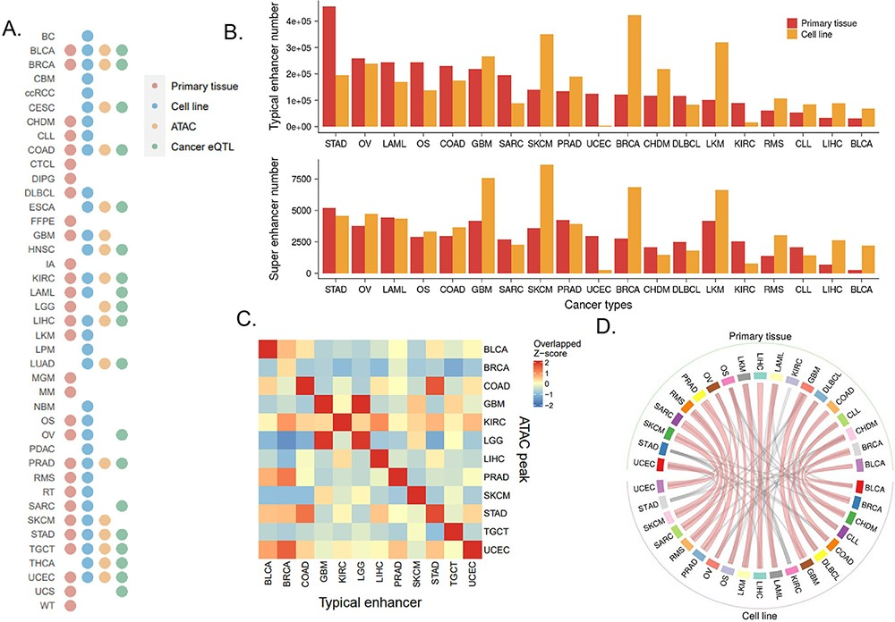
Figure 2. Overview of cancer typical enhancers and super-enhancers. (A) Distribution of samples of primary tissue ...
Notes:
Figure 2. Overview of cancer typical enhancers and super-enhancers. (A) Distribution of samples of primary tissue H3K27ac, cell line H3K27ac, cancer eQTL and primary tissue ATAC-Seq in cancer types. (B) The upper panel exhibits the distribution of reproducible typical enhancer number in cancer types, and the lower panel displays the distribution of merged super-enhancer number in cancer types. (C) The heatmap of the overlap between the primary tissue typical enhancer and the primary tissue ATAC-Seq ACRs. (D) Circos plot of the typical enhancer overlap between primary tissue and cell lines. Each tissue is linked to the top three overlapped cell lines, and the thickened linkage line indicates the same cancer type shared by tissue and cell line.
Unless provided in the caption above, the following copyright applies to the content of this slide: © The Author(s) 2023. Published by Oxford University Press.This is an Open Access article distributed under the terms of the Creative Commons Attribution License (https://creativecommons.org/licenses/by/4.0/), which permits unrestricted reuse, distribution, and reproduction in any medium, provided the original work is properly cited.

