Slide 1
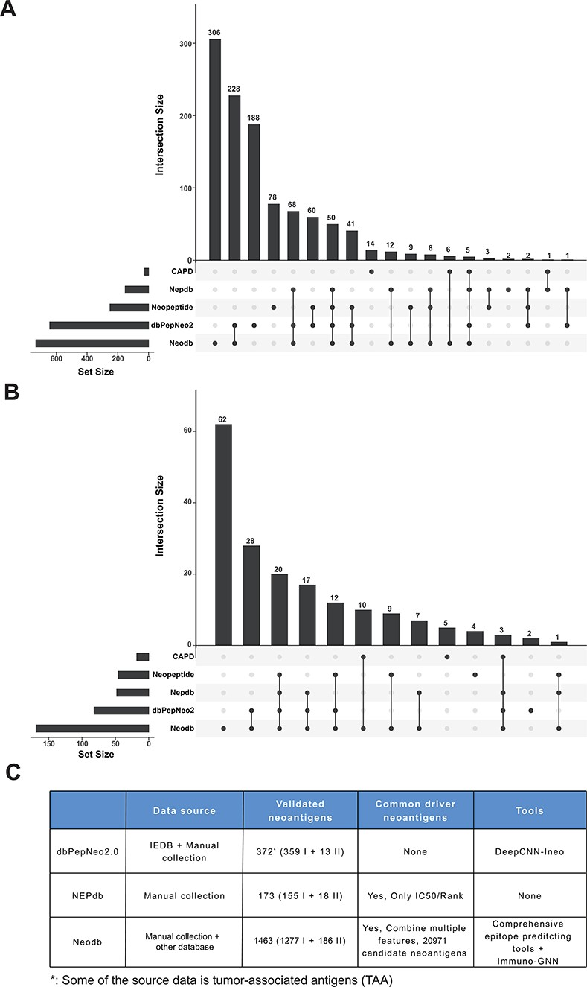
Figure 3. Comparison with other databases. (A) The amount of neoantigen–HLA pairs of different database and their ...
Notes:
Figure 3. Comparison with other databases. (A) The amount of neoantigen–HLA pairs of different database and their overlap. (B) The amount of research papers of different databases and their overlap. (C) Comparison of different databases, including data sources, the number of validated neoantigens and whether there is a list of candidate neoantigens derived from common cancer driver mutations. The neopeptide and cancer antigenic peptide database (CAPD) only have the neoantigen peptide sequence and do not include tools and other resources, therefore they are not shown in the table.
Unless provided in the caption above, the following copyright applies to the content of this slide: © The Author(s) 2023. Published by Oxford University Press.This is an Open Access article distributed under the terms of the Creative Commons Attribution License (https://creativecommons.org/licenses/by/4.0/), which permits unrestricted reuse, distribution, and reproduction in any medium, provided the original work is properly cited.

