Slide 1
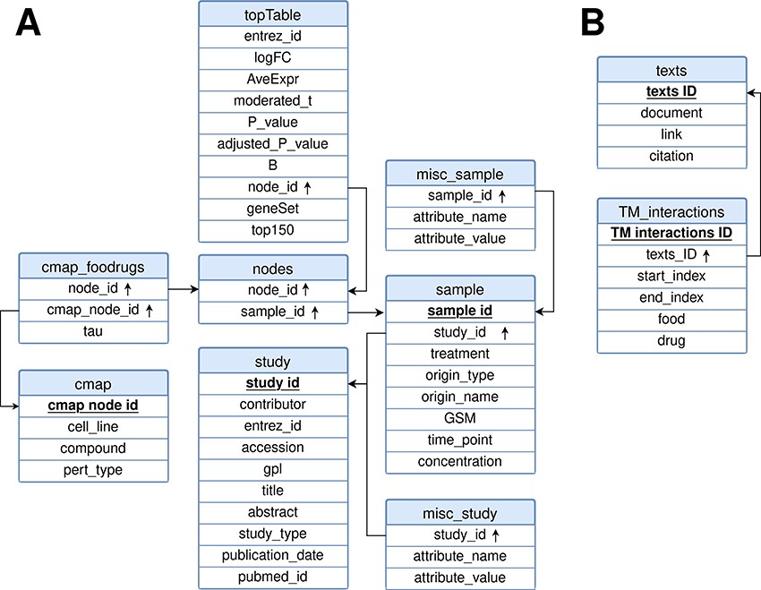
Figure 3. Relational model for the FooDrugs database. Primary keys for each table are marked in bold and underlined. ...
Notes:
Figure 3. Relational model for the FooDrugs database. Primary keys for each table are marked in bold and underlined. Foreign keys are marked by an arrow pointing upwards. The database is formed by two independent components: (A) a molecular component, built from GEO studies involving food compounds or bioactives, and (B) a text mining component, built using NLP.
Unless provided in the caption above, the following copyright applies to the content of this slide: © The Author(s) 2023. Published by Oxford University Press.This is an Open Access article distributed under the terms of the Creative Commons Attribution License (https://creativecommons.org/licenses/by/4.0/), which permits unrestricted reuse, distribution, and reproduction in any medium, provided the original work is properly cited.

