Slide 1
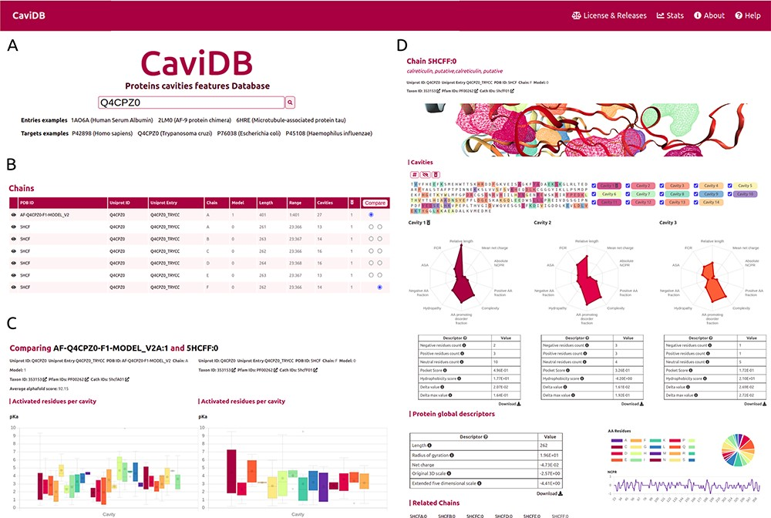
Figure 1. Overview of the CaviDB web application. (A) CaviDB search allows users to search for a specific PDB or ...
Notes:
Figure 1. Overview of the CaviDB web application. (A) CaviDB search allows users to search for a specific PDB or UniProt identifier. A selector is also provided to focus the search on AlphaFold models. (B, C) Cavity dynamics can be explored using the comparison tool provided by CaviDB, where predicted cavities and their features can be selected and displayed for different protein conformations simultaneously. (D) Schematic example of chain feature display. The information of each entry is divided into two main sections, one containing the general cavity descriptors (top) and the other containing the global protein descriptors (bottom).
Unless provided in the caption above, the following copyright applies to the content of this slide: © The Author(s) 2023. Published by Oxford University Press.This is an Open Access article distributed under the terms of the Creative Commons Attribution License (https://creativecommons.org/licenses/by/4.0/), which permits unrestricted reuse, distribution, and reproduction in any medium, provided the original work is properly cited.

Slide 2
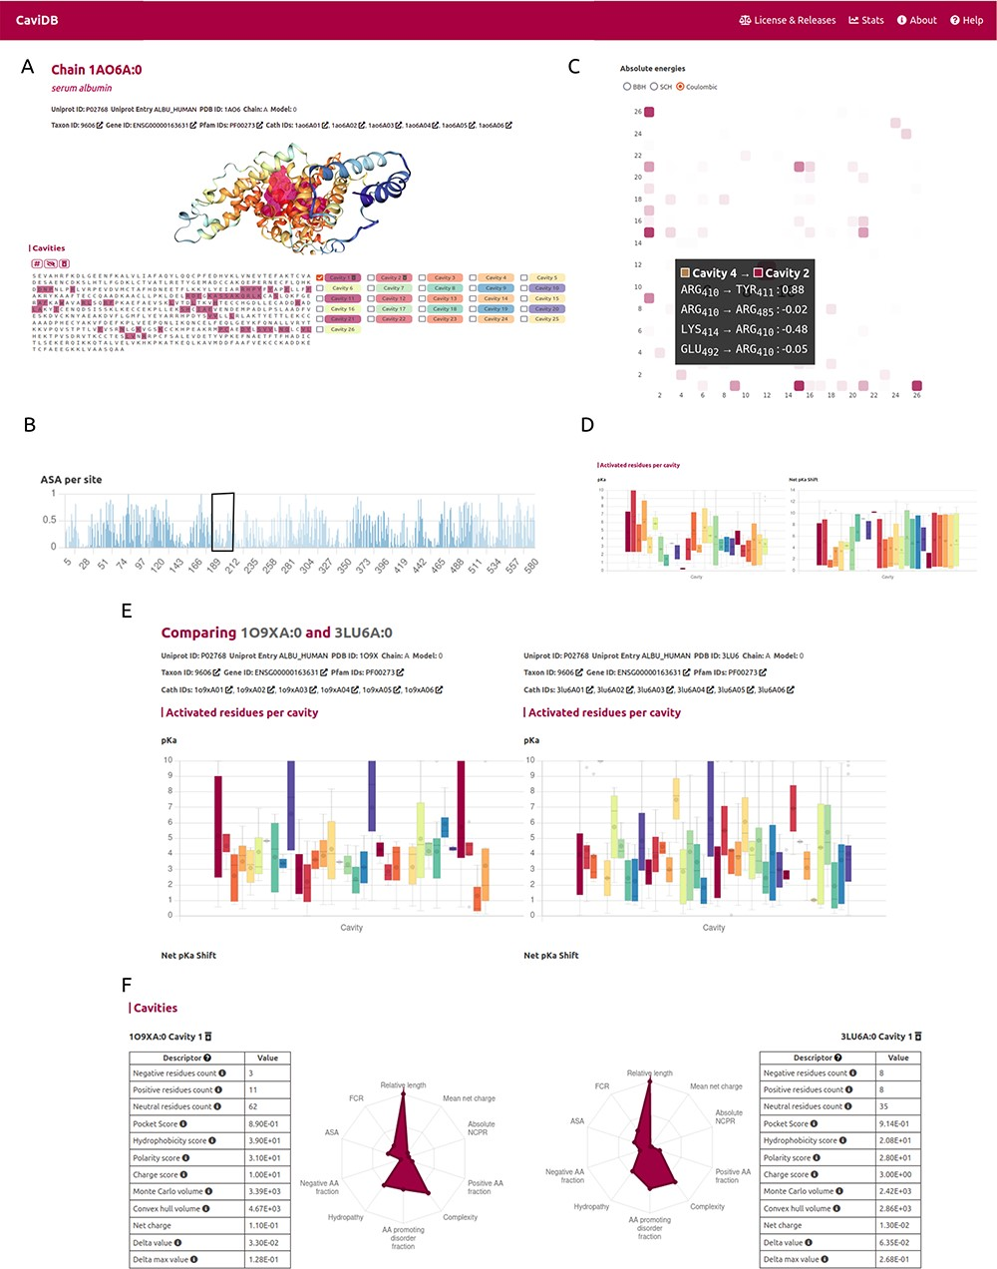
Figure 2. CaviDB display of HSA (PDB ID: 1AO6, chain: A, model: 0). (A) Display of protein and residues per cavity, ...
Notes:
Figure 2. CaviDB display of HSA (PDB ID: 1AO6, chain: A, model: 0). (A) Display of protein and residues per cavity, with Cavities 1 and 2 highlighted in the sequence (magenta and pink, respectively). (B) Bar plot of normalized accessible surface area per site. A box highlights a local minimum of ASA in the vicinity of Lys199. (C) Interactive heat map display of all possible pairwise contacts established between residues in different cavities. A popup window provides details on the absolute energies of the selected interaction. Heat map colors correspond to the number of interactions per cavity, the larger the interaction number is, the darker the color. (D) Boxplot distribution of pKa values (left) and pKa shifts (right) per residue in each detected cavity. (E) Comparison of HSA conformers with high RMSD. The panel shows important changes in acid–base properties in Cavity 1 resulting from the conformational changes (mean pKa = 3.99 in 3LU6_A vs. mean pKa = 5.16 in 1O9X_A), along with changes in other physicochemical features such as the number of charged amino acids, hydrophobicity and charge of residues (F).
Unless provided in the caption above, the following copyright applies to the content of this slide: © The Author(s) 2023. Published by Oxford University Press.This is an Open Access article distributed under the terms of the Creative Commons Attribution License (https://creativecommons.org/licenses/by/4.0/), which permits unrestricted reuse, distribution, and reproduction in any medium, provided the original work is properly cited.

Slide 3
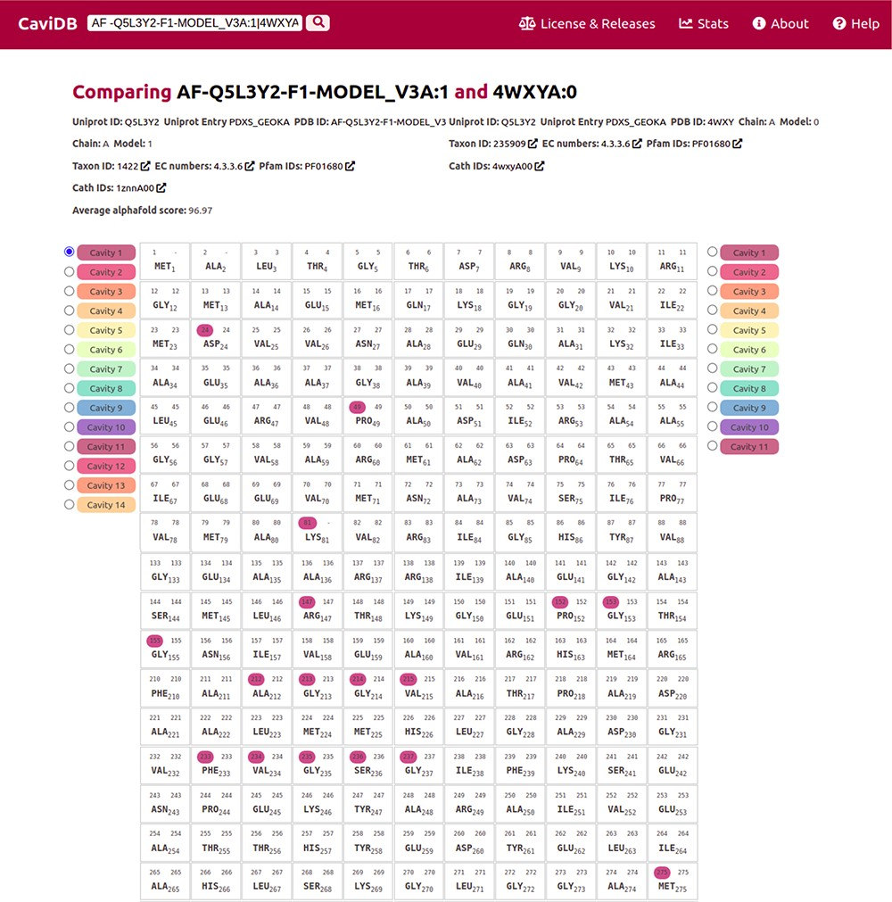
Figure 3. Comparison of the presence of cavities in PLP synthase conformers (UniProt ID Q5L3Y2). Using the expression ...
Notes:
Figure 3. Comparison of the presence of cavities in PLP synthase conformers (UniProt ID Q5L3Y2). Using the expression AF-Q5L3Y2-F1-MODEL_V3A:1|4WXYA:0 to search in CaviDB allows comparing the presence of cavities in both selected conformers. It can be seen that the AlphaFold model contains a biologically relevant cavity (Cavity 1) that contains the key residues described in the bibliography (56). This cavity is absent in other conformers due to the presence of disordered regions.
Unless provided in the caption above, the following copyright applies to the content of this slide: © The Author(s) 2023. Published by Oxford University Press.This is an Open Access article distributed under the terms of the Creative Commons Attribution License (https://creativecommons.org/licenses/by/4.0/), which permits unrestricted reuse, distribution, and reproduction in any medium, provided the original work is properly cited.

