Slide 1
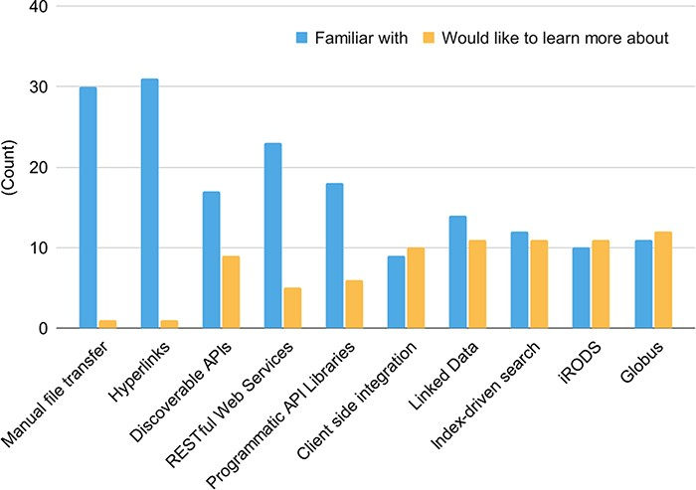
Figure 7. Familiarity with data-sharing technologies (blue) and data-sharing technology knowledge gaps (yellow). There ...
Notes:
Figure 7. Familiarity with data-sharing technologies (blue) and data-sharing technology knowledge gaps (yellow). There were 32 responses to this question.
Unless provided in the caption above, the following copyright applies to the content of this slide: Published by Oxford University Press 2023. This work is written by (a) US Government employee(s) and is in the public domain in the US.This work is written by (a) US Government employee(s) and is in the public domain in the US.

