Slide 1
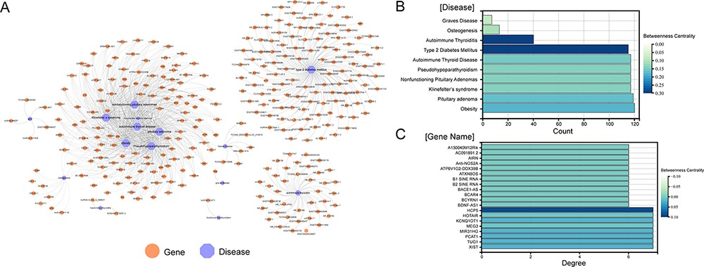
Figure 2. Visualization of all gene-disease associations in ENCD. (A) A network diagram constructed for all ...
Notes:
Figure 2. Visualization of all gene-disease associations in ENCD. (A) A network diagram constructed for all gene-diseases in ENCD, showing all disease and gene names in ENCD. (B) The betweenness centrality of endocrine diseases in the network. (C) The betweenness centrality of lncRNAs in the network.
Unless provided in the caption above, the following copyright applies to the content of this slide: © The Author(s) 2023. Published by Oxford University Press.This is an Open Access article distributed under the terms of the Creative Commons Attribution License (https://creativecommons.org/licenses/by/4.0/), which permits unrestricted reuse, distribution, and reproduction in any medium, provided the original work is properly cited.

