Slide 1
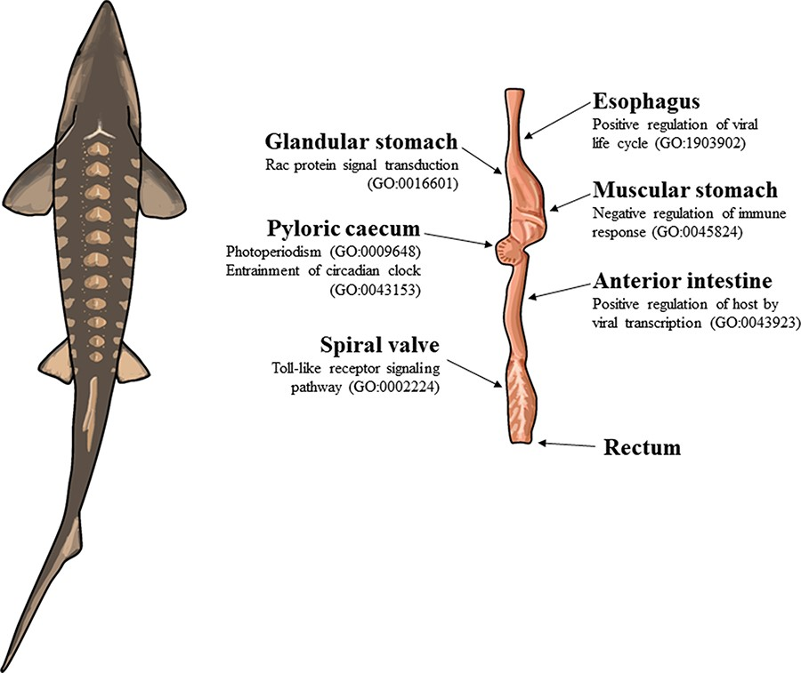
Figure 1. The illustration of a lake sturgeon (Acipenser fulvescens) and the gut tissues used for transcriptome ...
Notes:
Figure 1. The illustration of a lake sturgeon (Acipenser fulvescens) and the gut tissues used for transcriptome assemblies in the present study. Beneath most gut tissues are representative, significant (q < 0.05), GO terms unique to the tissue identified with enrichR. The GO terms present in the esophagus, glandular stomach, muscular stomach, anterior intestine and spiral valve represent possible innate immune system processes specific to each gut tissue in the present transcriptomes. The GO terms present in the pyloric cecum were processes related to circadian rhythms, unique to the tissue among the transcriptomes analyzed.
Unless provided in the caption above, the following copyright applies to the content of this slide: © The Author(s) 2023. Published by Oxford University Press.This is an Open Access article distributed under the terms of the Creative Commons Attribution License (https://creativecommons.org/licenses/by/4.0/), which permits unrestricted reuse, distribution, and reproduction in any medium, provided the original work is properly cited.

