Slide 1
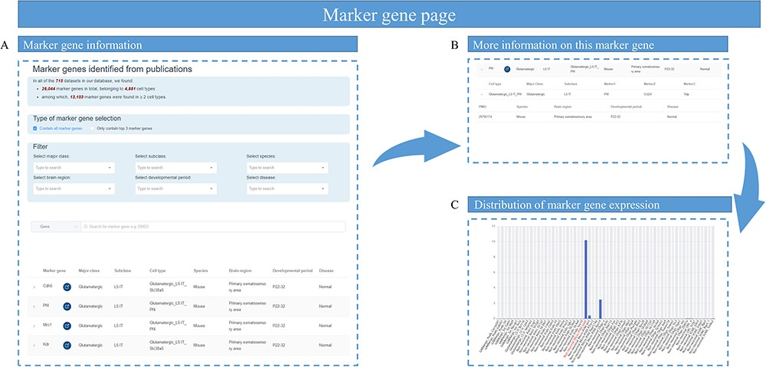
Figure 5. Overview of marker gene page. (A) The marker gene information table containing marker gene name, the link to ...
Notes:
Figure 5. Overview of marker gene page. (A) The marker gene information table containing marker gene name, the link to National Center for Biotechnology Information website and the cell types that contain this marker gene. (B) Sample information of this marker gene, such as the species, brain region, developmental stage and disease status. (C) A bar graph showing the expression of a marker gene among different cell types.
Unless provided in the caption above, the following copyright applies to the content of this slide: © The Author(s) 2023. Published by Oxford University Press.This is an Open Access article distributed under the terms of the Creative Commons Attribution License (https://creativecommons.org/licenses/by/4.0/), which permits unrestricted reuse, distribution, and reproduction in any medium, provided the original work is properly cited.

