Slide 1
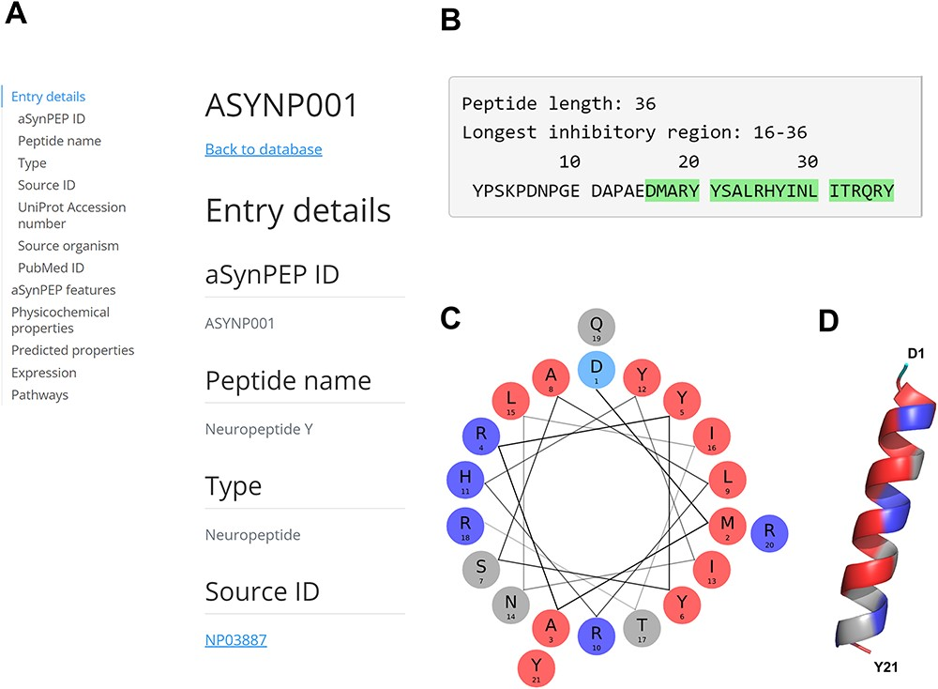
Figure 3. aSynPEP-DB record view for the human neuropeptide Y (ASYNP001). (A) Record view panel showing the information ...
Notes:
Figure 3. aSynPEP-DB record view for the human neuropeptide Y (ASYNP001). (A) Record view panel showing the information provided for each peptide, including entry details, aSynPEP features, physicochemical and predicted properties, expression and pathway information. (B) Peptide sequence with the inhibitory region detected by the discriminative algorithm highlighted in green. (C) Helical wheel representation for the NPY. Hydrophobic and positively charged residues are colored red and dark blue, respectively. (D) Predicted α-helical conformation obtained for the NPY. The structural model was obtained using AlphaFold through ColabFold. The amphipathic character of the helix is visualized with a hydrophobic face (in red) in front of a second cationic face (in dark blue).
Unless provided in the caption above, the following copyright applies to the content of this slide: © The Author(s) 2023. Published by Oxford University Press.This is an Open Access article distributed under the terms of the Creative Commons Attribution License (https://creativecommons.org/licenses/by/4.0/), which permits unrestricted reuse, distribution, and reproduction in any medium, provided the original work is properly cited.

