Slide 1
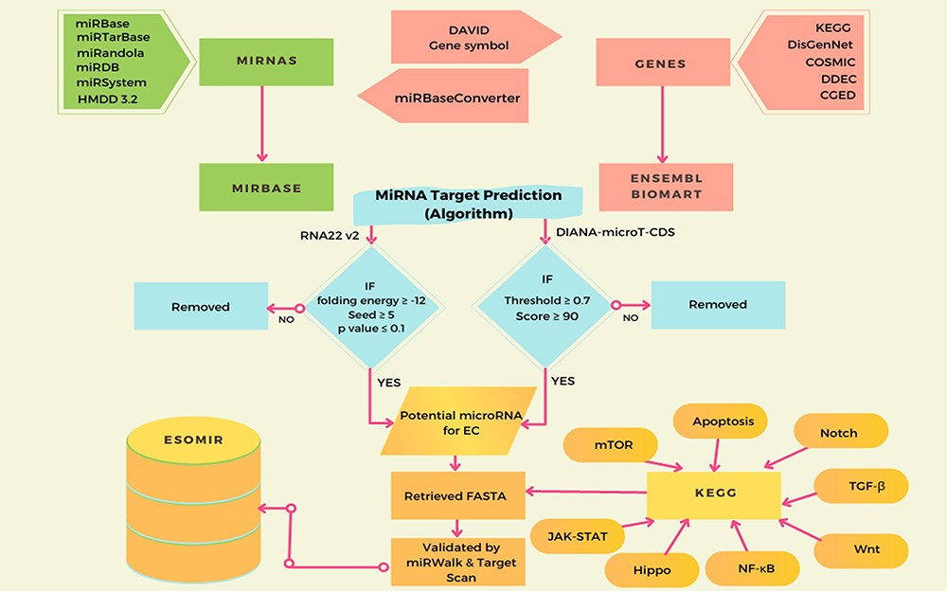
Figure 1. This diagram illustrates the ESOMIR modules, representing data analysis, prediction and mining procedures. ...
Notes:
Figure 1. This diagram illustrates the ESOMIR modules, representing data analysis, prediction and mining procedures. Each stage in the process is clearly defined in this schematic, outlining the steps taken to reach the desired outcome.
Unless provided in the caption above, the following copyright applies to the content of this slide: © The Author(s) 2023. Published by Oxford University Press.This is an Open Access article distributed under the terms of the Creative Commons Attribution License (https://creativecommons.org/licenses/by/4.0/), which permits unrestricted reuse, distribution, and reproduction in any medium, provided the original work is properly cited.

