Slide 1
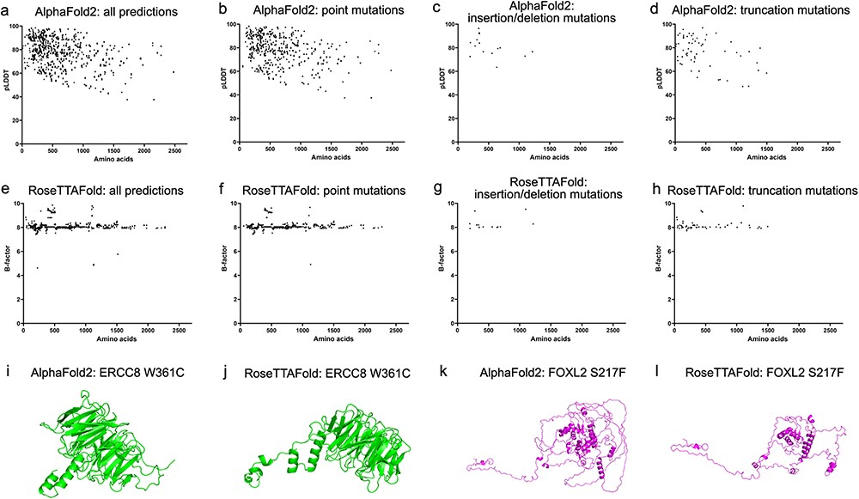
Figure 3. Model confidence profiling for ocular genes. (a and e) The pLDDT by AlphaFold2 and estimated CA rms error by ...
Notes:
Figure 3. Model confidence profiling for ocular genes. (a and e) The pLDDT by AlphaFold2 and estimated CA rms error by RoseTTAFold for each prediction were plotted with the number of residues. (b–d and f–h) The pLDDT and estimated CA rms error were plotted according to different types of mutations.
Unless provided in the caption above, the following copyright applies to the content of this slide: © The Author(s) 2023. Published by Oxford University Press.This is an Open Access article distributed under the terms of the Creative Commons Attribution License (https://creativecommons.org/licenses/by/4.0/), which permits unrestricted reuse, distribution, and reproduction in any medium, provided the original work is properly cited.

