Slide 1
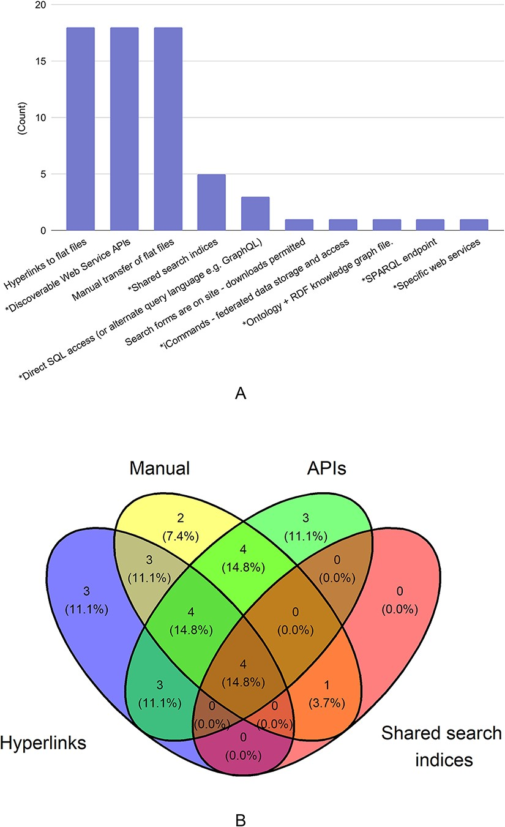
Figure 1. Mechanisms used for data sharing. There were 29 responses to this question. In Figure 1A, mechanisms that ...
Notes:
Figure 1. Mechanisms used for data sharing. There were 29 responses to this question. In Figure 1A, mechanisms that allow for programmatic access to the shared data are marked with asterisk (*). In Figure 1B, the four data types with the most responses are shown in a venn diagram.
Unless provided in the caption above, the following copyright applies to the content of this slide: Published by Oxford University Press 2023. This work is written by (a) US Government employee(s) and is in the public domain in the US.This work is written by (a) US Government employee(s) and is in the public domain in the US.

