Slide 1
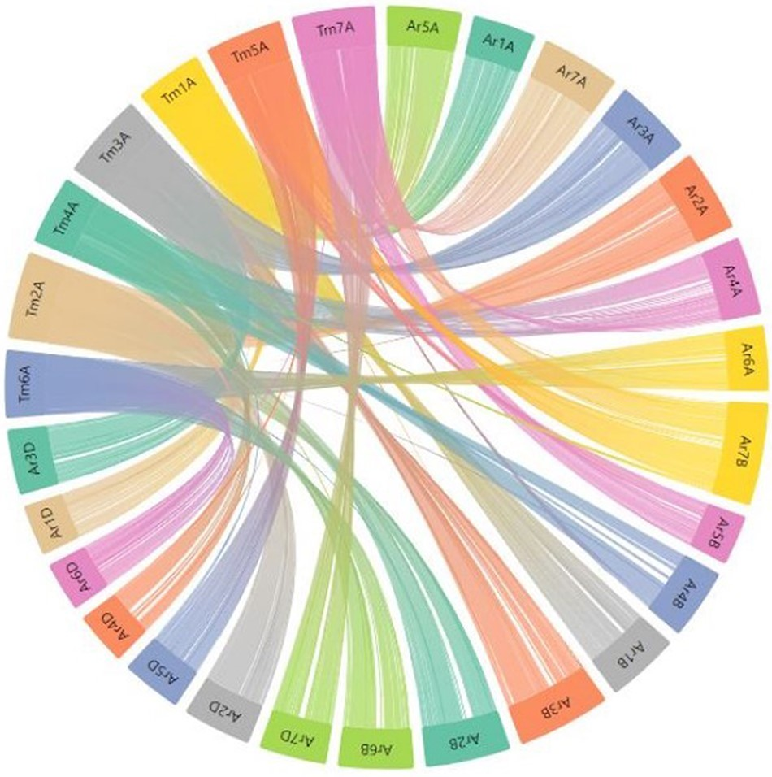
Figure 9. Part of the webpage shows a synteny between the T. monococcum TA10622 and T. aestivum ArinaLrFor. The figure ...
Notes:
Figure 9. Part of the webpage shows a synteny between the T. monococcum TA10622 and T. aestivum ArinaLrFor. The figure is available on the synteny tab of einkorn wheat resource database web page by selecting the respective genome. This figure can also be generated by uploading the two precomputed files (gff and collinearity) provided on the synteny tab of einkorn resource database web page on the AccuSyn server.
Unless provided in the caption above, the following copyright applies to the content of this slide: © The Author(s) 2023. Published by Oxford University Press.This is an Open Access article distributed under the terms of the Creative Commons Attribution License (https://creativecommons.org/licenses/by/4.0/), which permits unrestricted reuse, distribution, and reproduction in any medium, provided the original work is properly cited.

