Slide 1
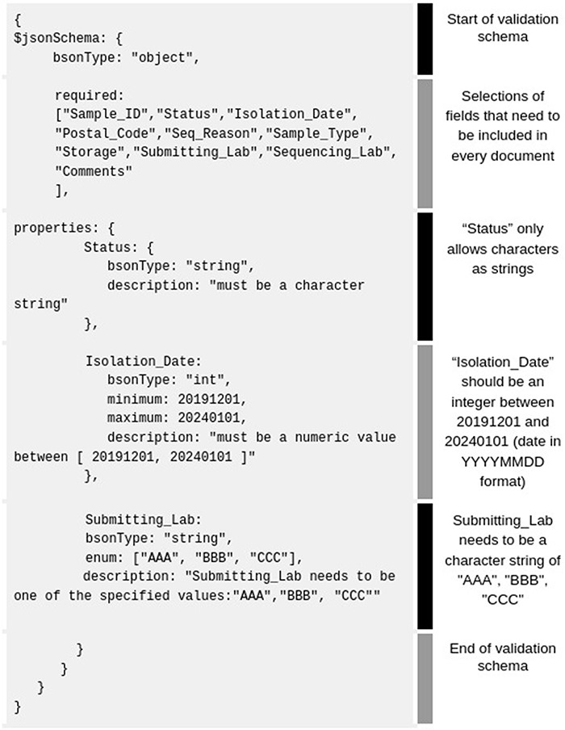
Figure 4. Example of basic MongoDB schema rules (gray background) accepted by the MongoDB Compass validation tab. For ...
Notes:
Figure 4. Example of basic MongoDB schema rules (gray background) accepted by the MongoDB Compass validation tab. For better clarity, we added our own fields like ‘Status’, ‘Isolation _ Date’, ‘Submitting_ Lab’, etc.
Unless provided in the caption above, the following copyright applies to the content of this slide: © The Author(s) 2023. Published by Oxford University Press.This is an Open Access article distributed under the terms of the Creative Commons Attribution License (https://creativecommons.org/licenses/by/4.0/), which permits unrestricted reuse, distribution, and reproduction in any medium, provided the original work is properly cited.

