Slide 1
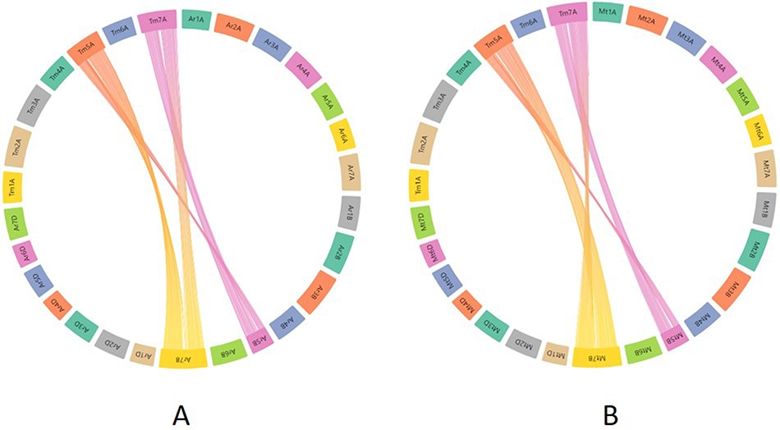
Figure 10. Synteny visualization of T. monococcum with ArinaLrFor (A) and SY Mattis (B). It shows the presence of a ...
Notes:
Figure 10. Synteny visualization of T. monococcum with ArinaLrFor (A) and SY Mattis (B). It shows the presence of a translocation between chromosomes 5B and 7B of ArinaLrFor (A) and SY Mattis (B). The figure was generated by uploading the two precomputed files (gff and collinearity) provided on the synteny tab of einkorn resource database web page and viewed on the AccuSyn server by selecting the respective chromosomes.
Unless provided in the caption above, the following copyright applies to the content of this slide: © The Author(s) 2023. Published by Oxford University Press.This is an Open Access article distributed under the terms of the Creative Commons Attribution License (https://creativecommons.org/licenses/by/4.0/), which permits unrestricted reuse, distribution, and reproduction in any medium, provided the original work is properly cited.

