Slide 1
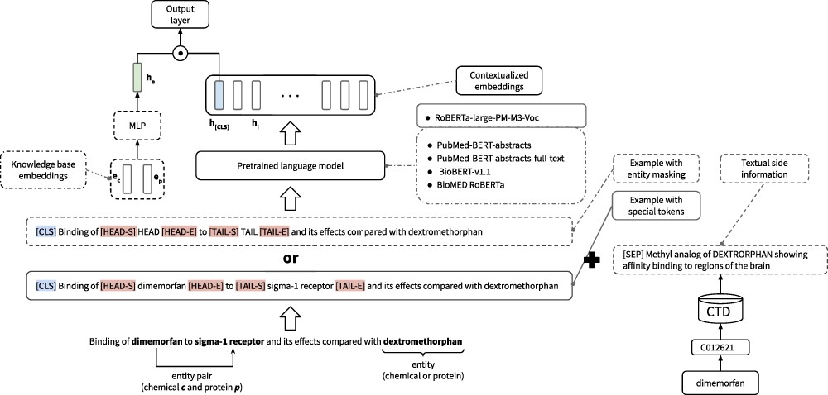
Figure 1. Overview of our base model and all evaluated extensions. Solid lines indicate the components of the base ...
Notes:
Figure 1. Overview of our base model and all evaluated extensions. Solid lines indicate the components of the base model, whereas dashed lines indicate evaluated extensions. We create one input example per chemical–protein pair in each sentence and mark the pair with special tokens. This sentence is embedded with a pretrained language model. Finally, the embedding of the [CLS] special token is passed through an output layer. As pretrained language model, we use RoBERTa-large-p.m.-M3-Voc in our base model and evaluate replacing it with four other variants. Textual information is appended to the input text, and KBEs are concatenated with the [CLS] embedding.
Unless provided in the caption above, the following copyright applies to the content of this slide: © The Author(s) 2022. Published by Oxford University Press.This is an Open Access article distributed under the terms of the Creative Commons Attribution-NonCommercial License (https://creativecommons.org/licenses/by-nc/4.0/), which permits non-commercial re-use, distribution, and reproduction in any medium, provided the original work is properly cited. For commercial re-use, please contact journals.permissions@oup.com

Slide 2
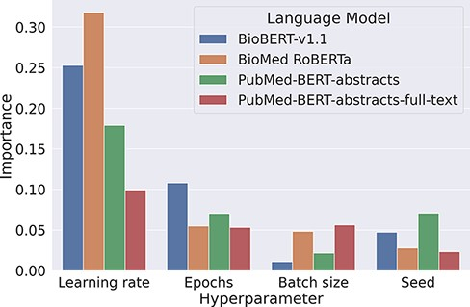
Figure 2. Overview about the importance of different hyperparameters using the fANOVA framework (53).
Notes:
Figure 2. Overview about the importance of different hyperparameters using the fANOVA framework (53).
Unless provided in the caption above, the following copyright applies to the content of this slide: © The Author(s) 2022. Published by Oxford University Press.This is an Open Access article distributed under the terms of the Creative Commons Attribution-NonCommercial License (https://creativecommons.org/licenses/by-nc/4.0/), which permits non-commercial re-use, distribution, and reproduction in any medium, provided the original work is properly cited. For commercial re-use, please contact journals.permissions@oup.com

Slide 3
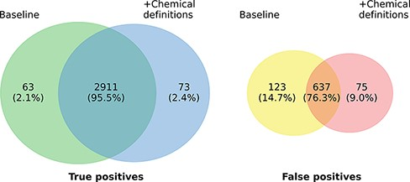
Figure 3. Prediction overlap concerning TPs (left) and FPs (right) between an ensemble of baseline models and an ...
Notes:
Figure 3. Prediction overlap concerning TPs (left) and FPs (right) between an ensemble of baseline models and an ensemble of models extended with chemical descriptions.
Unless provided in the caption above, the following copyright applies to the content of this slide: © The Author(s) 2022. Published by Oxford University Press.This is an Open Access article distributed under the terms of the Creative Commons Attribution-NonCommercial License (https://creativecommons.org/licenses/by-nc/4.0/), which permits non-commercial re-use, distribution, and reproduction in any medium, provided the original work is properly cited. For commercial re-use, please contact journals.permissions@oup.com

