Slide 1
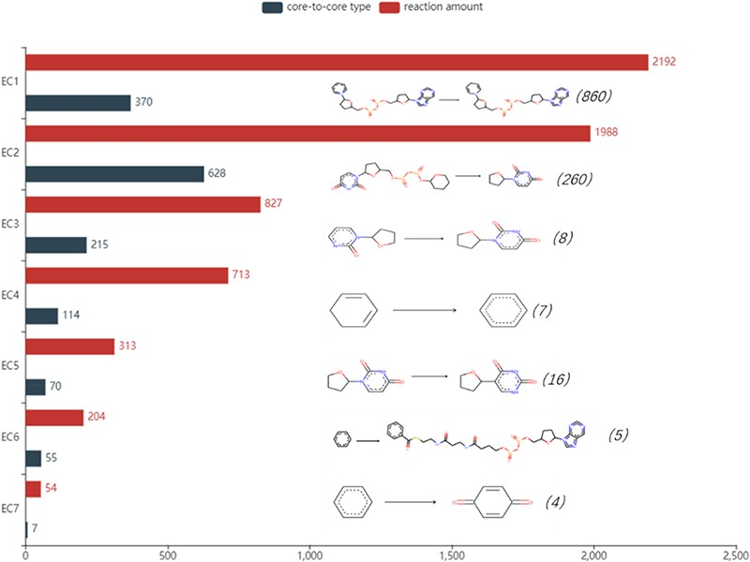
Figure 5. Detailed reaction amount and core-to-core type in seven types of enzymes, the most frequent amount marked in ...
Notes:
Figure 5. Detailed reaction amount and core-to-core type in seven types of enzymes, the most frequent amount marked in the parentheses and core-to-core pictures are listed on the right of the bar graph. EC1: Oxidoreductases, EC2: Transferases, EC3: Hydrolases, EC4: Lyases, EC5: Isomerases, EC6: Ligases, EC7: Translocases.
Unless provided in the caption above, the following copyright applies to the content of this slide: © The Author(s) 2020. Published by Oxford University Press.This is an Open Access article distributed under the terms of the Creative Commons Attribution License (http://creativecommons.org/licenses/by/4.0/), which permits unrestricted reuse, distribution, and reproduction in any medium, provided the original work is properly cited.

