Slide 1
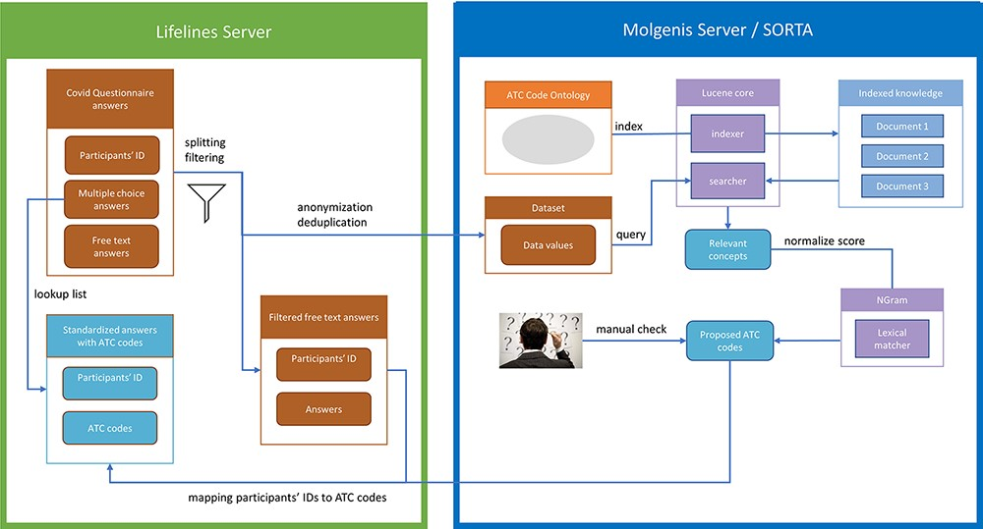
Figure 2. Process overview. Pre-processing and anonymization occurs on the Lifelines server. Actual mapping with SORTA ...
Notes:
Figure 2. Process overview. Pre-processing and anonymization occurs on the Lifelines server. Actual mapping with SORTA takes place on the Molgenis server. Finally, the results are mapped back using the pre-processed answers. Adapted from Pang et al., 2015 (9).
Unless provided in the caption above, the following copyright applies to the content of this slide: © The Author(s) 2023. Published by Oxford University Press.This is an Open Access article distributed under the terms of the Creative Commons Attribution License (https://creativecommons.org/licenses/by/4.0/), which permits unrestricted reuse, distribution, and reproduction in any medium, provided the original work is properly cited.

