Slide 1
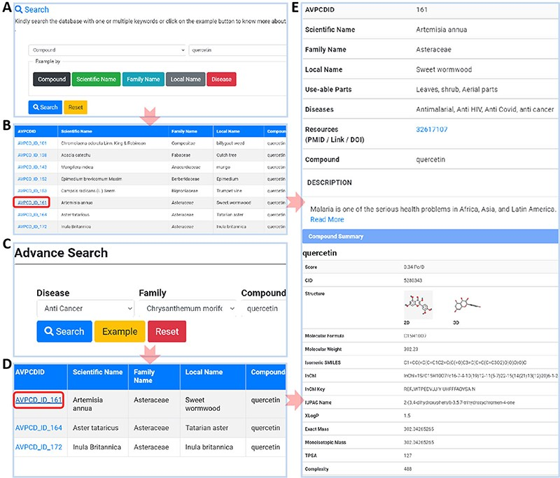
Figure 3. Usage of AVPCD. (A) The simple search with five search options. (B) The compound list by the selected option ...
Notes:
Figure 3. Usage of AVPCD. (A) The simple search with five search options. (B) The compound list by the selected option in simple search. (C) The advanced search of the AVPCD. (D) The compound list by the advanced search. (E) All the needed and final data of the searched query.
Unless provided in the caption above, the following copyright applies to the content of this slide: © The Author(s) 2023. Published by Oxford University Press.This is an Open Access article distributed under the terms of the Creative Commons Attribution License (https://creativecommons.org/licenses/by/4.0/), which permits unrestricted reuse, distribution, and reproduction in any medium, provided the original work is properly cited.

