Slide 1
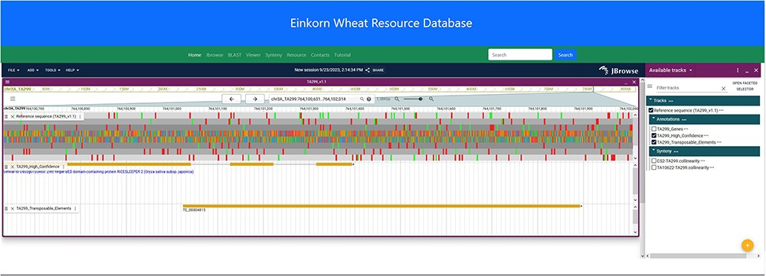
Figure 4. JBrowse2 Linear genome viewer page showing T. monococcum TA299 assembly, a gene structure, and a transposable ...
Notes:
Figure 4. JBrowse2 Linear genome viewer page showing T. monococcum TA299 assembly, a gene structure, and a transposable element. Users can scroll through the genome and can see available tracks from the panel on the right.
Unless provided in the caption above, the following copyright applies to the content of this slide: © The Author(s) 2023. Published by Oxford University Press.This is an Open Access article distributed under the terms of the Creative Commons Attribution License (https://creativecommons.org/licenses/by/4.0/), which permits unrestricted reuse, distribution, and reproduction in any medium, provided the original work is properly cited.

