Slide 1
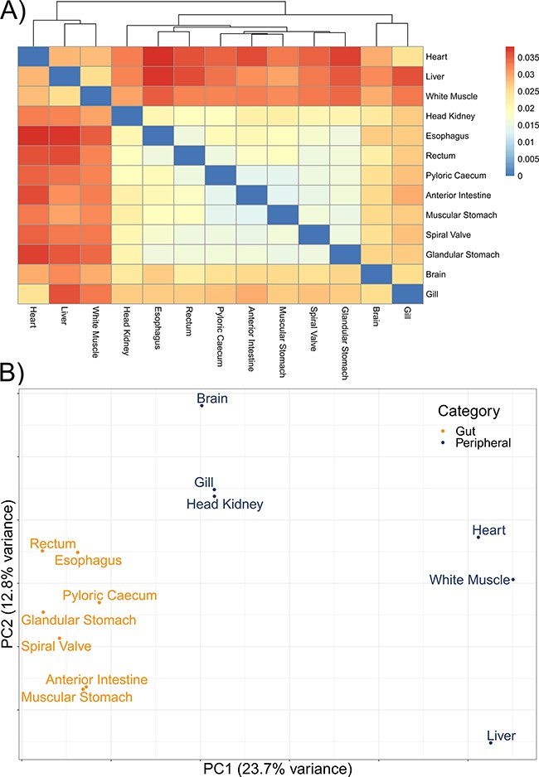
Figure 3. The divergence among 13 tissue-specific transcriptomes of the lake sturgeon (Acipenser fulvescens). (A) A ...
Notes:
Figure 3. The divergence among 13 tissue-specific transcriptomes of the lake sturgeon (Acipenser fulvescens). (A) A heatmap of pairwise distances between transcriptomes assessed with Mash, where higher Mash distances correspond to greater evolutionary divergence between the transcriptomes. Because no evolutionary divergence is expected for transcriptomes from one population of one species, these distances represent isoforms and paralogs of gene models. Higher values indicate more divergence. (B) A PCA of the present and absent genes in the 13 transcriptomes, performed with prcomp in R. Gut and peripheral tissues were distinguished for visualization, where gut tissues were the esophagus, glandular stomach, muscular stomach, anterior intestine, spiral valve and rectum, while peripheral tissues were the brain, gill, head kidney, heart, white muscle and liver. The distinction in color between gut and peripheral tissues is only for visualization and was not used to categorize data a priori in the PCA.
Unless provided in the caption above, the following copyright applies to the content of this slide: © The Author(s) 2023. Published by Oxford University Press.This is an Open Access article distributed under the terms of the Creative Commons Attribution License (https://creativecommons.org/licenses/by/4.0/), which permits unrestricted reuse, distribution, and reproduction in any medium, provided the original work is properly cited.

