Slide 1
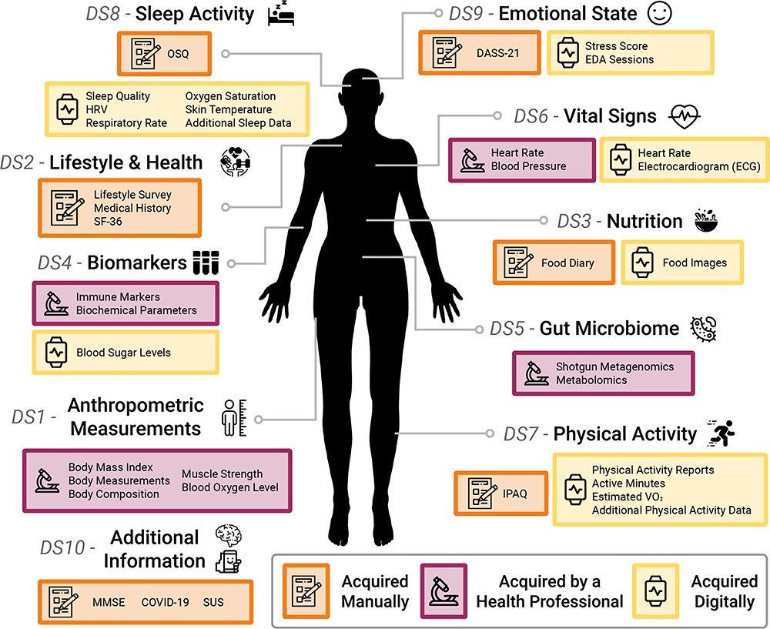
Figure 1. An overview of the AI4FoodDB. The database comprises 10 datasets representing different types of data ...
Notes:
Figure 1. An overview of the AI4FoodDB. The database comprises 10 datasets representing different types of data acquired during the nutritional intervention: Anthropometric Measurements (DS1), Lifestyle and Health (DS2), Nutrition (DS3), Biomarkers (DS4), Gut Microbiome (DS5), Vital Signs (DS6), Physical Activity (DS7), Sleep Activity (DS8), Emotional State (DS9) and Additional Information (DS10). Data acquisition methods are indicated by different colored boxes as well as by icons: manual (depicted with a notebook), clinical (microscope) or digital (smartwatch).
Unless provided in the caption above, the following copyright applies to the content of this slide: © The Author(s) 2023. Published by Oxford University Press.This is an Open Access article distributed under the terms of the Creative Commons Attribution License (https://creativecommons.org/licenses/by/4.0/), which permits unrestricted reuse, distribution, and reproduction in any medium, provided the original work is properly cited.

