Slide 1
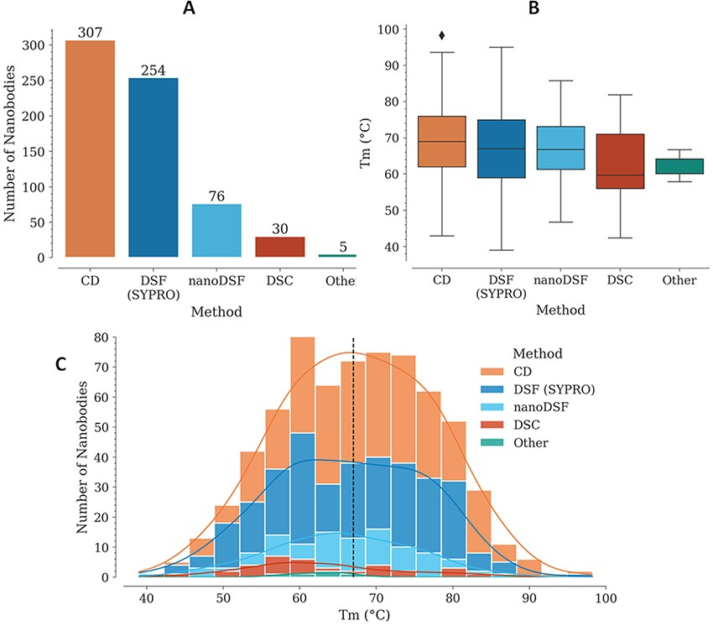
Figure 1. T_{m} data in the NbThermo database. (A) Distribution of T_{m} measurements by experimental ...
Notes:
Figure 1. Tm data in the NbThermo database. (A) Distribution of Tm measurements by experimental methods: CD, DSF with SYPRO Orange, nanoDSF and DSC. (B) Distribution of Tm values as measured using different experimental methods. The box represents the interquartile range, the horizontal line within the box represents the median and the bottom and upper lines account for the minimum and maximum Tm, respectively. (C) Distribution of Tm values across the database, showing with stacked bars the use of the different experimental methods. The median value is highlighted by a vertical dashed line.
Unless provided in the caption above, the following copyright applies to the content of this slide: © The Author(s) 2023. Published by Oxford University Press.This is an Open Access article distributed under the terms of the Creative Commons Attribution License (https://creativecommons.org/licenses/by/4.0/), which permits unrestricted reuse, distribution, and reproduction in any medium, provided the original work is properly cited.

