Slide 1
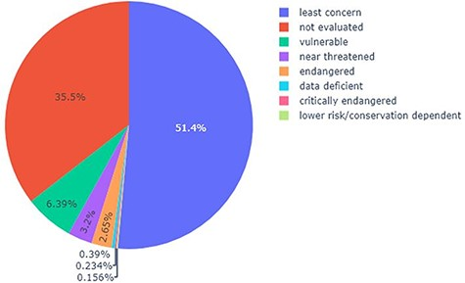
Figure 5. Pie chart showing the percentage of each category (according to the IUCN Red List) present in the list of ...
Notes:
Figure 5. Pie chart showing the percentage of each category (according to the IUCN Red List) present in the list of trees in the DRC, capable of providing timber.
Unless provided in the caption above, the following copyright applies to the content of this slide: © The Author(s) 2023. Published by Oxford University Press.This is an Open Access article distributed under the terms of the Creative Commons Attribution License (https://creativecommons.org/licenses/by/4.0/), which permits unrestricted reuse, distribution, and reproduction in any medium, provided the original work is properly cited.

