Slide 1
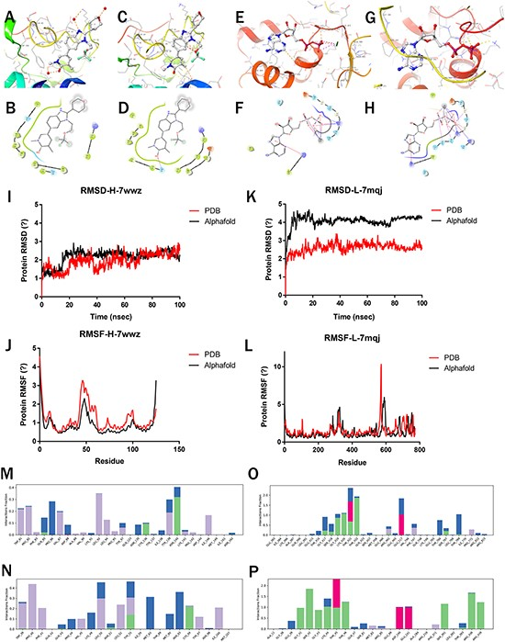
Figure 4. Molecular simulations of Highlighted predictions compared with PDB structures. (a–b) 7wwz-PDB-Protein docking ...
Notes:
Figure 4. Molecular simulations of Highlighted predictions compared with PDB structures. (a–b) 7wwz-PDB-Protein docking with 7ow; (c–d) 7wwz-Alphafold-Protein docking with 7ow; (e–f) 7mqj-PDB-Protein docking with ADP; (g–h) 7mqj-Alphafold-Protein docking with ADP; (i–k) RMSD of 7wwz and 7mqj; (j–l) RMSF of 7wwz and 7mqj; (m–p) Complex interaction: (m) 7wwz-PDB-Complex, (n) 7wwz-Alphafold-Complex, (o) 7mqj-PDB-Complex, (p) 7mqj-Alphafold-Complex.
Unless provided in the caption above, the following copyright applies to the content of this slide: © The Author(s) 2023. Published by Oxford University Press.This is an Open Access article distributed under the terms of the Creative Commons Attribution License (https://creativecommons.org/licenses/by/4.0/), which permits unrestricted reuse, distribution, and reproduction in any medium, provided the original work is properly cited.

