Slide 1
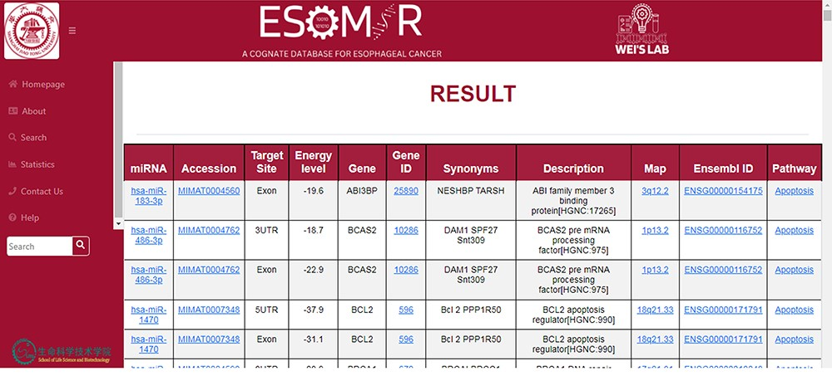
Figure 6. An illustration of the ESOMIR result page presented in a tabular format. The results show the miRNA, ...
Notes:
Figure 6. An illustration of the ESOMIR result page presented in a tabular format. The results show the miRNA, accession ID, target site, EL and other information including the gene name and pathways.
Unless provided in the caption above, the following copyright applies to the content of this slide: © The Author(s) 2023. Published by Oxford University Press.This is an Open Access article distributed under the terms of the Creative Commons Attribution License (https://creativecommons.org/licenses/by/4.0/), which permits unrestricted reuse, distribution, and reproduction in any medium, provided the original work is properly cited.

