Slide 1
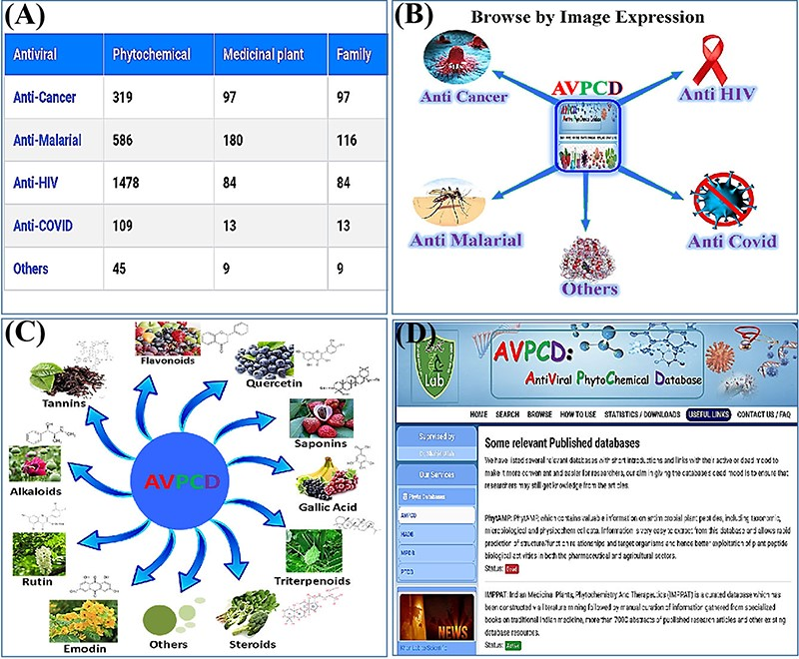
Figure 4. Usage of the database. (A) The browse option by antiviral category. (B) Browse by disease-wise image ...
Notes:
Figure 4. Usage of the database. (A) The browse option by antiviral category. (B) Browse by disease-wise image expression. (C) Browse page of the AVPCD based on the top 10 rich compound images and formula. (D) Useful links to the relevant databases with two modes.
Unless provided in the caption above, the following copyright applies to the content of this slide: © The Author(s) 2023. Published by Oxford University Press.This is an Open Access article distributed under the terms of the Creative Commons Attribution License (https://creativecommons.org/licenses/by/4.0/), which permits unrestricted reuse, distribution, and reproduction in any medium, provided the original work is properly cited.

