Slide 1
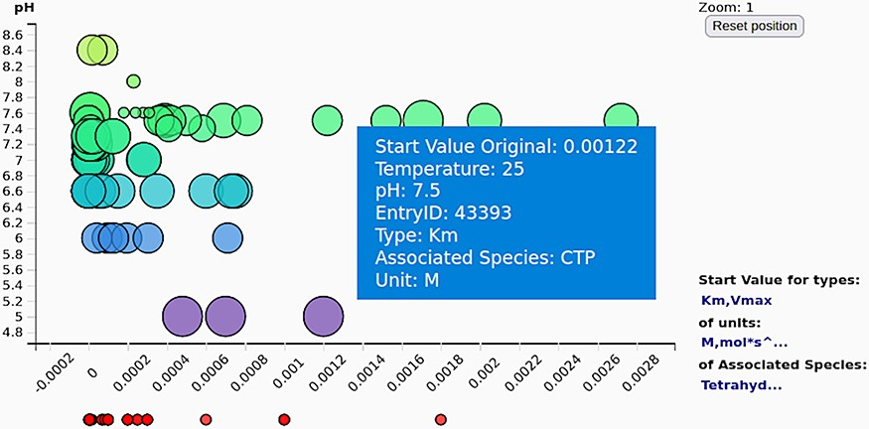
Figure 6. The scatter plot of the kinetic parameter values (here shown against the pH values) gives an overview of the ...
Notes:
Figure 6. The scatter plot of the kinetic parameter values (here shown against the pH values) gives an overview of the exact values of the selected kinetic parameters (often not deductible from the axis tick denotations on the parallel coordinates).
Unless provided in the caption above, the following copyright applies to the content of this slide: © The Author(s) 2023. Published by Oxford University Press.This is an Open Access article distributed under the terms of the Creative Commons Attribution License (https://creativecommons.org/licenses/by/4.0/), which permits unrestricted reuse, distribution, and reproduction in any medium, provided the original work is properly cited.

